Slide 1
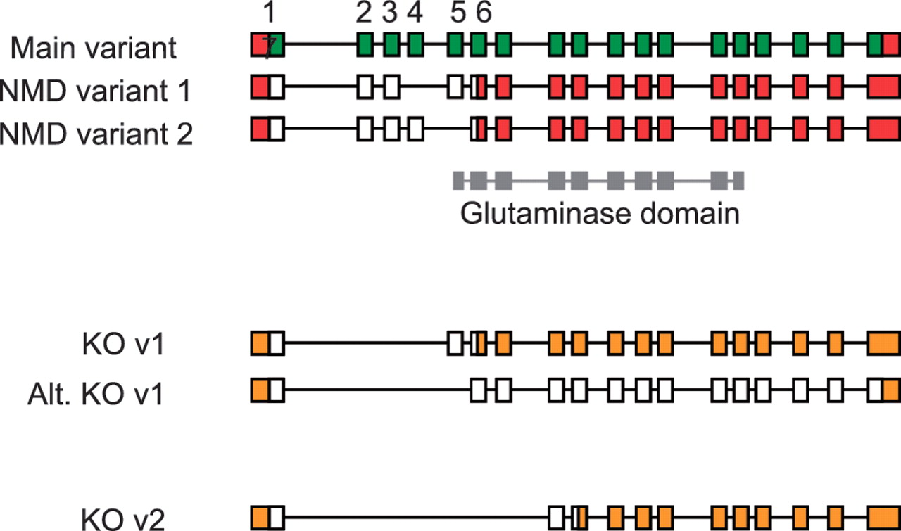
Figure 7 Validation of vector designs for Gls2 gene. The main exon structure of Gls2 (main variant) is displayed ...
Notes:
Figure 7 Validation of vector designs for Gls2 gene. The main exon structure of Gls2 (main variant) is displayed alongside NMD variants 1 and 2 based on mRNAs BC02566.1 and AK039618.1, respectively. Hypothetical knockout (KO) transcripts based on annotated structures are shown. Knockout transcript, KO v1, is derived from the main variant and NMD variant 1, where as the alternative version (Alt. KO v1) is derived from NMD variant 2. Exons 1 to 7 are numbered with coding regions displayed in green (main variant) or white (NMD and KO variants) and untranslated regions (UTR) shown in red or orange. The Gls2 glutaminase domain is shown in grey, overlapping exon structure.
Unless provided in the caption above, the following copyright applies to the content of this slide: © The Author(s) 2012. Published by Oxford University Press.This is an Open Access article distributed under the terms of the Creative Commons Attribution Non-Commercial License (http://creativecommons.org/licenses/by-nc/3.0), which permits unrestricted non-commercial use, distribution, and reproduction in any medium, provided the original work is properly cited.

