Slide 1
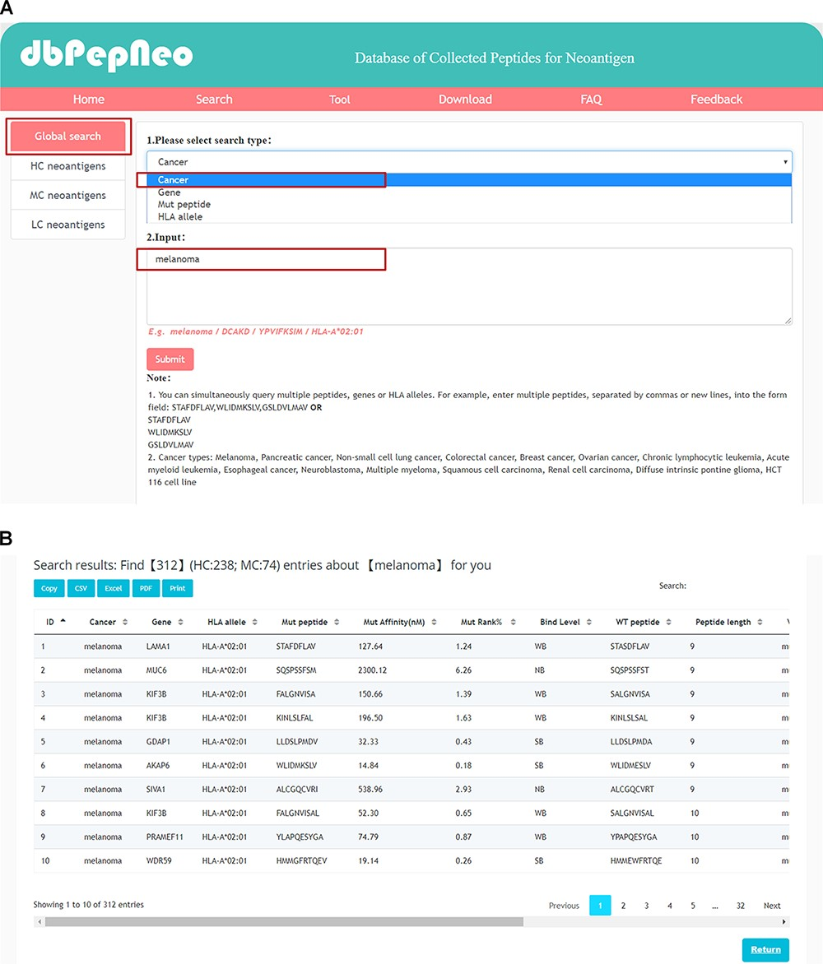
Figure 4 Searching and results presentation in dbPepNeo. (A) The workflow of searching in dbPepNeo. (B) Results of ...
Notes:
Figure 4 Searching and results presentation in dbPepNeo. (A) The workflow of searching in dbPepNeo. (B) Results of melanoma under the search of cancer type. Cancer: cancer type; Gene: gene name; HLA allele: HLA allele; Mut peptide: mutated peptide sequence; Mut affinity (nM): mutated peptide affinity IC50 (nM), the predicted binding affinity between mutant peptide and HLA allele by NetMHCpan (v4.0); Mut %Rank: %Rank of mutated peptide, the predicted binding affinity between mutant peptide and HLA allele by NetMHCpan (v4.0); Mut binding level: binding level between mutant peptide and HLA allele; WT peptide: wild type peptide sequence; Peptide length: the number of amino acids contained in the peptide; Mutation: amino acid change; Verification: method of experimental verification; Reference: the supporting literature link; ‘/’: information not provided in the original article is marked as ‘/’.
Unless provided in the caption above, the following copyright applies to the content of this slide: © The Author(s) 2020. Published by Oxford University Press.This is an Open Access article distributed under the terms of the Creative Commons Attribution License (http://creativecommons.org/licenses/by/4.0/), which permits unrestricted reuse, distribution, and reproduction in any medium, provided the original work is properly cited.

