Slide 1
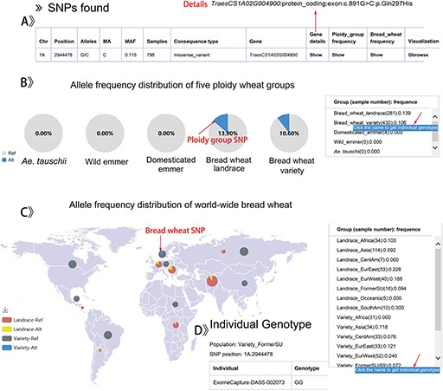
Figure 4. The result display by searching a SNP data for example.
Notes:
Figure 4. The result display by searching a SNP data for example. A. Detailed annotation of a SNP in TraesCS1A02G004900 gene. B. The pie-chart of allele frequency distribution for five ploidy wheat groups. C. Display format of the allele frequency for the SNP of 17 worldwide bread wheat groups. D. The individual genotypes in the group of Variety_FormerSU.
Unless provided in the caption above, the following copyright applies to the content of this slide: © The Author(s) 2020. Published by Oxford University Press.This is an Open Access article distributed under the terms of the Creative Commons Attribution License (http://creativecommons.org/licenses/by/4.0/), which permits unrestricted reuse, distribution, and reproduction in any medium, provided the original work is properly cited.

