Slide 1
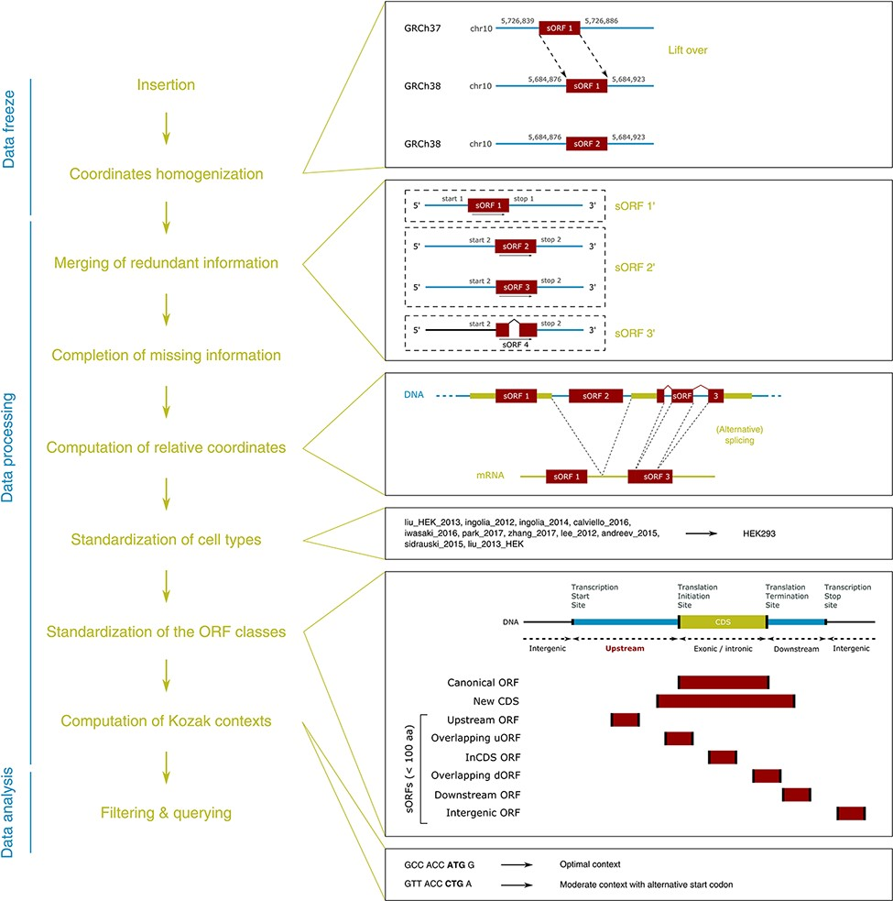
Figure 1. MetamORF pipeline. This figure represents the workflow used to build MetamORF. First, the data from the ...
Notes:
Figure 1. MetamORF pipeline. This figure represents the workflow used to build MetamORF. First, the data from the sources selected have been inserted into the database, and the absolute genomic coordinates have been homogenized from their original annotation version to the most recent version (GRCh38 or GRCm38). Then, the redundant information, i.e. the entries describing the same ORFs (same start, stop and splicing), has been merged, allowing to get one single and unique entries for each ORF detected on the human and mouse genomes. The missing information (sequences and transcript biotypes) has been downloaded from Ensembl, and the ORF relative coordinates have been computed. Finally, the cell types and ORF classes have been normalized, and the Kozak contexts have been computed using the sequences flanking the start codons.
Unless provided in the caption above, the following copyright applies to the content of this slide: © The Author(s) 2021. Published by Oxford University Press.This is an Open Access article distributed under the terms of the Creative Commons Attribution License (http://creativecommons.org/licenses/by/4.0/), which permits unrestricted reuse, distribution, and reproduction in any medium, provided the original work is properly cited.

