Slide 1
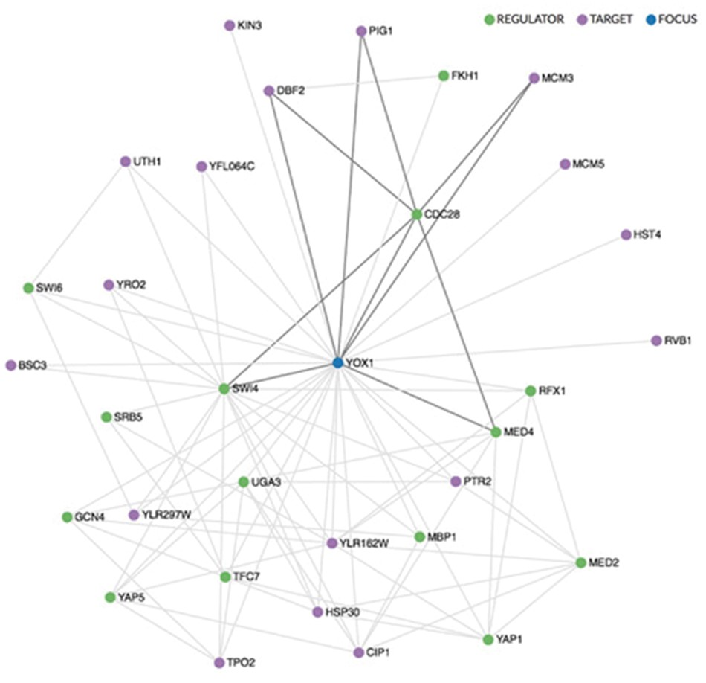
Figure 1. Regulatory network visualization for YOX1, shown in blue. The network is drawn using the sigma.js ...
Notes:
Figure 1. Regulatory network visualization for YOX1, shown in blue. The network is drawn using the sigma.js visualization library (sigmajs.org). Regulators are indicated in green, targets in purple. Mousing over any gene in the network highlights its local sub-network, as indicated here for CDC28, a regulator of YOX1.
Unless provided in the caption above, the following copyright applies to the content of this slide: © The Author(s) 2018. Published by Oxford University Press.This is an Open Access article distributed under the terms of the Creative Commons Attribution License (http://creativecommons.org/licenses/by/4.0/), which permits unrestricted reuse, distribution, and reproduction in any medium, provided the original work is properly cited.

