Slide 1
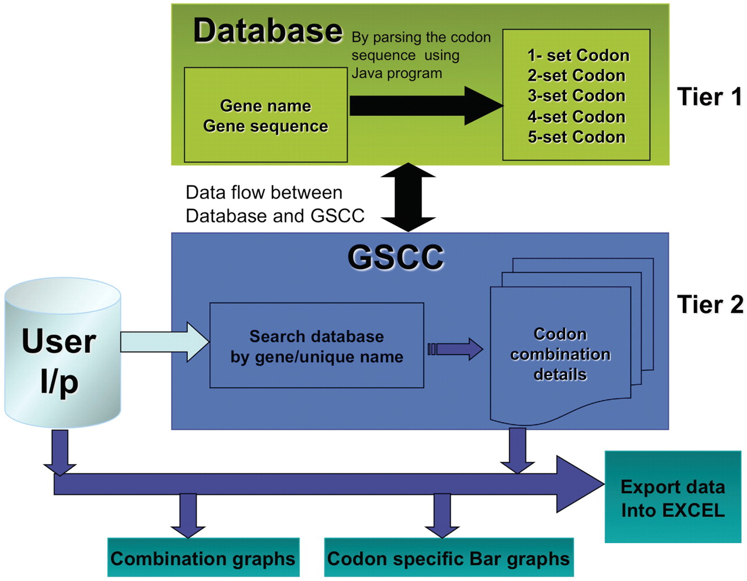
Figure 1 GSCC core architecture. Overview of the GSCC two tier architecture. Tier 1: The database contains the main ...
Notes:
Figure 1 GSCC core architecture. Overview of the GSCC two tier architecture. Tier 1: The database contains the main gene names and codon gene sequences of 5780 genes taken from S. cerevisiae. Using the codon gene sequence information, we quantitated the number of individual codons as well as all two set, three set, four set and five set codon combinations in each gene. Tier 2: The GSCC user visual interface takes user defined input (gene name or search string) and searches the database for a matching gene name with the given search string and then retrieves that gene's codon sequences (individual codons as well as all two set, three set, four set and five set codon combinations). Users can visualize the codon sequences as bar graphs and as combination graphs. (Refer to Figure 3 for combination graphs). Users can also export the codon information into Excel.
Unless provided in the caption above, the following copyright applies to the content of this slide: © The Author(s) 2012. Published by Oxford University Press.This is an Open Access article distributed under the terms of the Creative Commons Attribution Non-Commercial License (http://creativecommons.org/licenses/by-nc/3.0), which permits unrestricted non-commercial use, distribution, and reproduction in any medium, provided the original work is properly cited.

