Slide 1
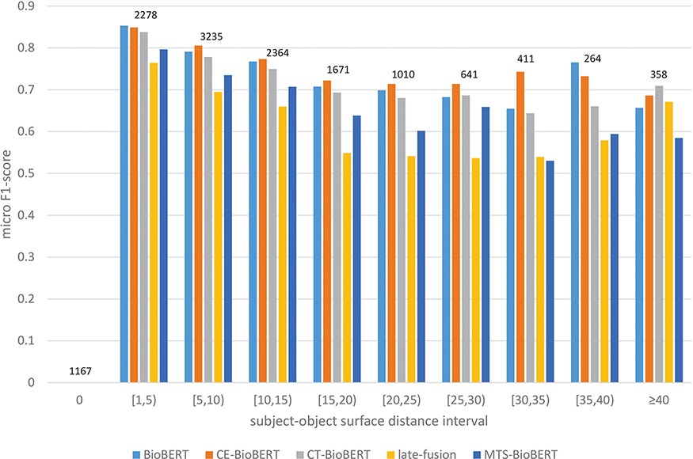
Figure 7. Stratified results on DrugProt validation set: Examples in the validation set are regrouped based on their ...
Notes:
Figure 7. Stratified results on DrugProt validation set: Examples in the validation set are regrouped based on their subject–object surface distances. Intervals are of length 5 except two special cases 0 and $ \ge $40. For each interval, the number of examples that fall in this interval is shown on top of bars.
Unless provided in the caption above, the following copyright applies to the content of this slide: © The Author(s) 2022. Published by Oxford University Press.This is an Open Access article distributed under the terms of the Creative Commons Attribution-NonCommercial License (https://creativecommons.org/licenses/by-nc/4.0/), which permits non-commercial re-use, distribution, and reproduction in any medium, provided the original work is properly cited. For commercial re-use, please contact journals.permissions@oup.com

