Slide 1
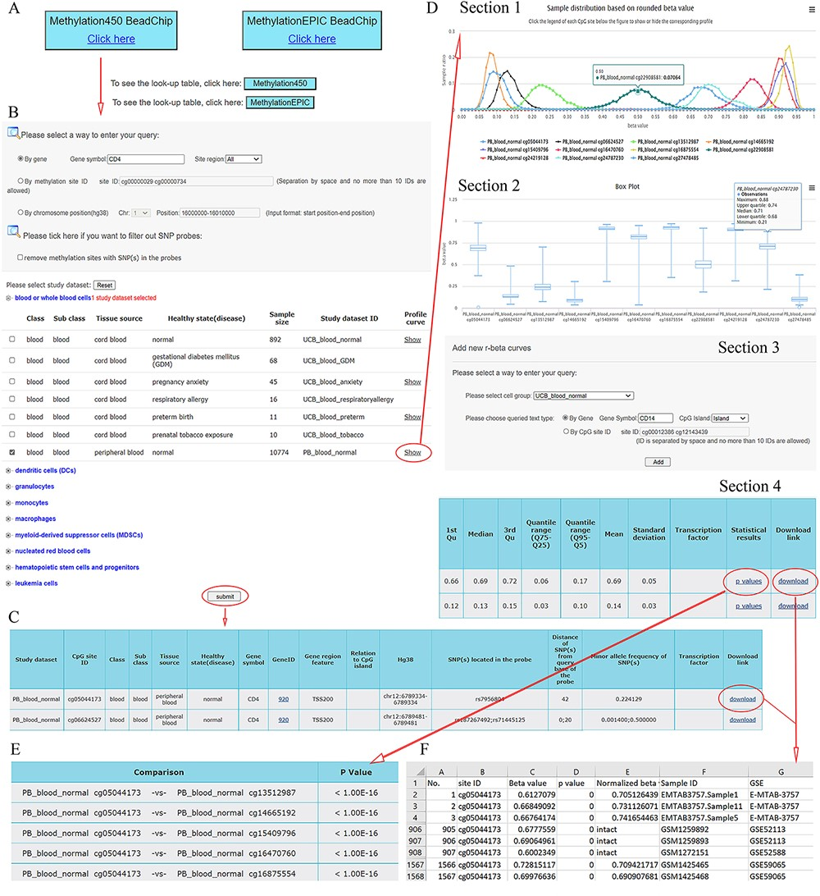
Figure 2. A workflow to navigate the database, using CD4 as an example. (A) The Methylation450 BeadChip platform is ...
Notes:
Figure 2. A workflow to navigate the database, using CD4 as an example. (A) The Methylation450 BeadChip platform is selected. B. The gene symbol “CD4” was used to search “All” possible methylation sites in the study dataset PB_blood_normal (normal human peripheral blood cells). The “Reset” button is used to deselect all study datasets. C. On the beta value result page, a basic description of all retrieved methylation sites is given. Beta values can be downloaded via the “download” button. D. On the methylation profile result page, four sections are included. Section 1 directly shows methylation profiles by the r-beta curve, which indicates the extent of MPL, the distributions of beta values and the overall methylation intensities. Section 2 uses box plots to show beta value distributions. Section 3 provides a curve addition function, facilitating the addition of new profiles for comparison. Section 4 shows the basic descriptions, such as quartiles, mean, standard deviation and quantile ranges of the beta values, for all retrieved sites. Beta values and results of statistical comparisons can be downloaded via the corresponding links. E. Statistical comparisons between the site in the indicated row and the sites in the other rows. A lower P-value indicates a greater statistical significance of the observed differential methylation levels. F. The beta value result. The meaning of the headings is shown as follows. The “p value” reflects statistical significance between the true hybridization signal and the background signal. The “intact” symbols, but not the numeric values (which represent recalculated values), in the column “Normalized beta value” indicate the beta values in the column “Beta value” represent preprocessed values that are directly from the data submitter. Sample IDs and data source study IDs are shown in the columns “Sample ID” and “GSE,” respectively. See the operation steps in the main text for more details. Web page figures are cropped to fit the page.
Unless provided in the caption above, the following copyright applies to the content of this slide: © The Author(s) 2022. Published by Oxford University Press.This is an Open Access article distributed under the terms of the Creative Commons Attribution License (https://creativecommons.org/licenses/by/4.0/), which permits unrestricted reuse, distribution, and reproduction in any medium, provided the original work is properly cited.

