Slide 1
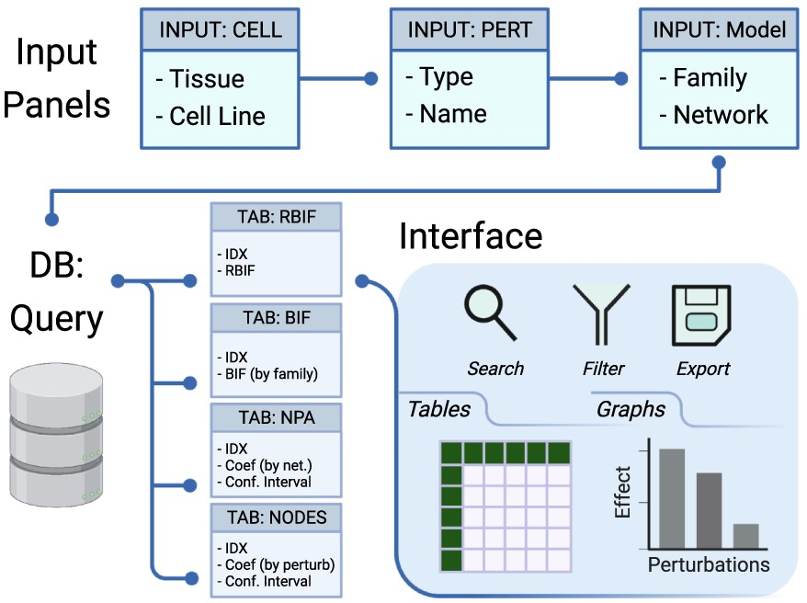
Figure 2. Description of the database and the interface. The interface includes input panels to query the database, and ...
Notes:
Figure 2. Description of the database and the interface. The interface includes input panels to query the database, and the output is sent back to the interface. The query is constructed by selecting the cell lines from one or more tissues, the drug perturbations grouped by mechanism of action, and the network models of interest. The output of the database query is three main tables: the BIF, NPA and code contributions (NODES). The output is returned in tabular and graphical formats that can be searched, filtered or exported.
Unless provided in the caption above, the following copyright applies to the content of this slide: © The Author(s) 2021. Published by Oxford University Press.This is an Open Access article distributed under the terms of the Creative Commons Attribution License (http://creativecommons.org/licenses/by/4.0/), which permits unrestricted reuse, distribution, and reproduction in any medium, provided the original work is properly cited.

