Slide 1
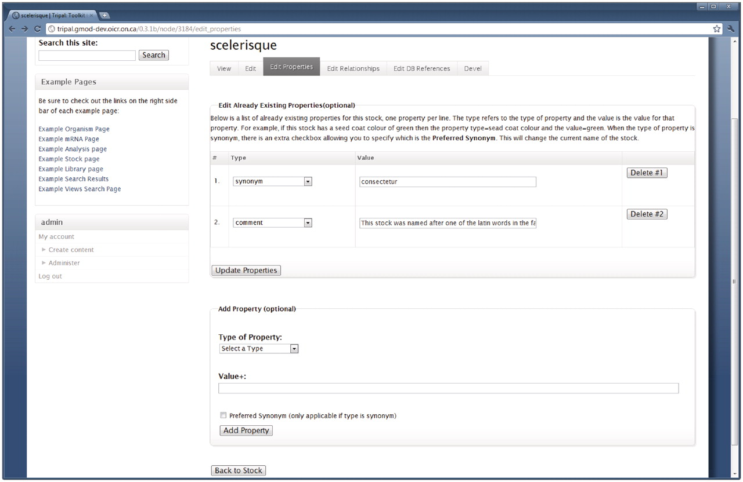
Figure 8. The interface for editing stock properties. Content managers with proper privilege may use this form to edit ...
Notes:
Figure 8. The interface for editing stock properties. Content managers with proper privilege may use this form to edit the properties of a stock. This example is for editing the stock shown in Figure 7, and is available by clicking the ‘Edit Properties’ tab at the top of the Stock page. The first fieldset lists all current properties for the stock and allows the content manager to change the property type or edit the text for the property. The content manager can also delete a property by clicking the ‘Delete’ button to the right side of the property. The second fieldset allows for adding new properties to the current stock. Editing relationships and references is done in a similar manner.
Unless provided in the caption above, the following copyright applies to the content of this slide: © The Author(s) 2011. Published by Oxford University Press.This is an Open Access article distributed under the terms of the Creative Commons Attribution Non-Commercial License (http://creativecommons.org/licenses/by-nc/3.0), which permits unrestricted non-commercial use, distribution, and reproduction in any medium, provided the original work is properly cited.

