Slide 1
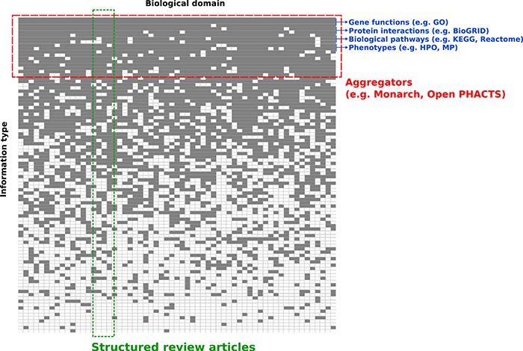
Figure 1 Conceptual overview of structured review articles. This figure represents the distribution of knowledge in ...
Notes:
Figure 1 Conceptual overview of structured review articles. This figure represents the distribution of knowledge in databases accessible to the community in terms of domains compiled (X axis) and information structured (Y axis). Gray squares indicate knowledge focus of a database with regards to the domain(s) and information structured.
Unless provided in the caption above, the following copyright applies to the content of this slide: © The Author(s) 2020. Published by Oxford University Press.This is an Open Access article distributed under the terms of the Creative Commons Attribution License (http://creativecommons.org/licenses/by/4.0/), which permits unrestricted reuse, distribution, and reproduction in any medium, provided the original work is properly cited.

Slide 2
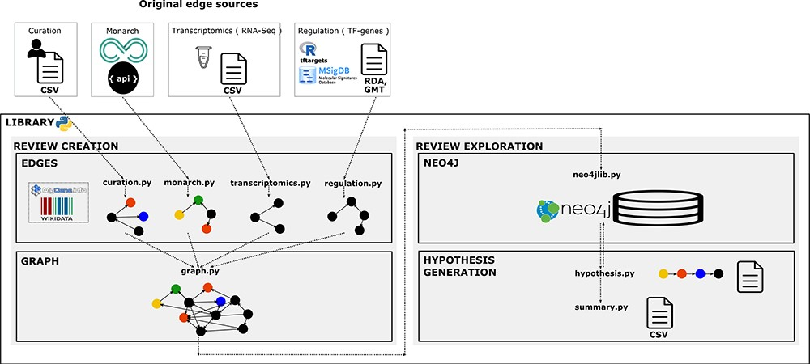
Figure 2 Library architecture. Architecture of the system based on four components. The edges component contains ...
Notes:
Figure 2 Library architecture. Architecture of the system based on four components. The edges component contains libraries with functions to collect, normalize and format the information and data resources we want to integrate as individual networks. The graph component contains functions to integrate and create the knowledge graph. The Neo4j component contains the module to import the graph into Neo4j. Finally, the hypothesis-generation component contains the modules to query the graph, structure the resulting semantic paths and extract summaries to analyse connections and the evidence.
Unless provided in the caption above, the following copyright applies to the content of this slide: © The Author(s) 2020. Published by Oxford University Press.This is an Open Access article distributed under the terms of the Creative Commons Attribution License (http://creativecommons.org/licenses/by/4.0/), which permits unrestricted reuse, distribution, and reproduction in any medium, provided the original work is properly cited.

Slide 3
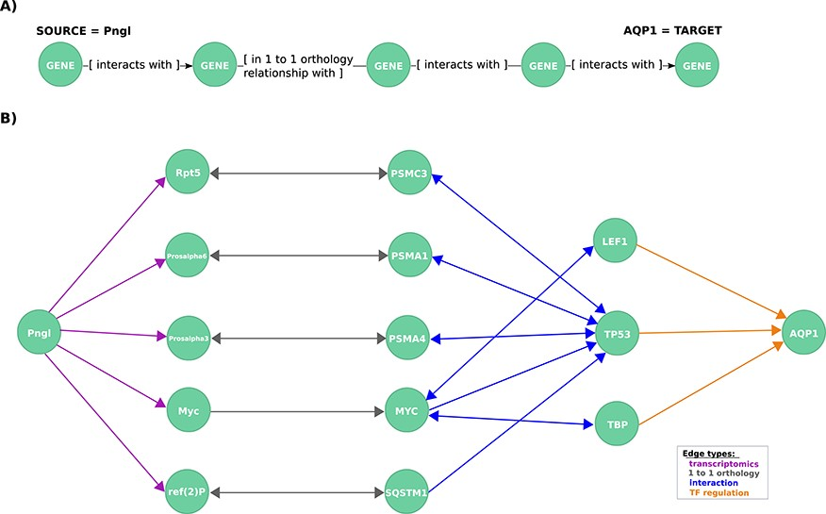
Figure 3 Exploration of mechanistic paths between NGLY1 and AQP1 based on the regulatory hypothesis. (A) First query ...
Notes:
Figure 3 Exploration of mechanistic paths between NGLY1 and AQP1 based on the regulatory hypothesis. (A) First query topology for the regulatory hypothesis. We defined a path topology based on gene pathways of length four linking the NGLY1 ortholog in Drosophila (Pngl) with the human AQP1 gene. The bridging nodes and edges were based on transcriptional regulatory relationships in both Drosophila and human, plus orthology relationships between human and fly genes. (B) Mechanistic hypotheses resulted from the first query.
Unless provided in the caption above, the following copyright applies to the content of this slide: © The Author(s) 2020. Published by Oxford University Press.This is an Open Access article distributed under the terms of the Creative Commons Attribution License (http://creativecommons.org/licenses/by/4.0/), which permits unrestricted reuse, distribution, and reproduction in any medium, provided the original work is properly cited.

Slide 4
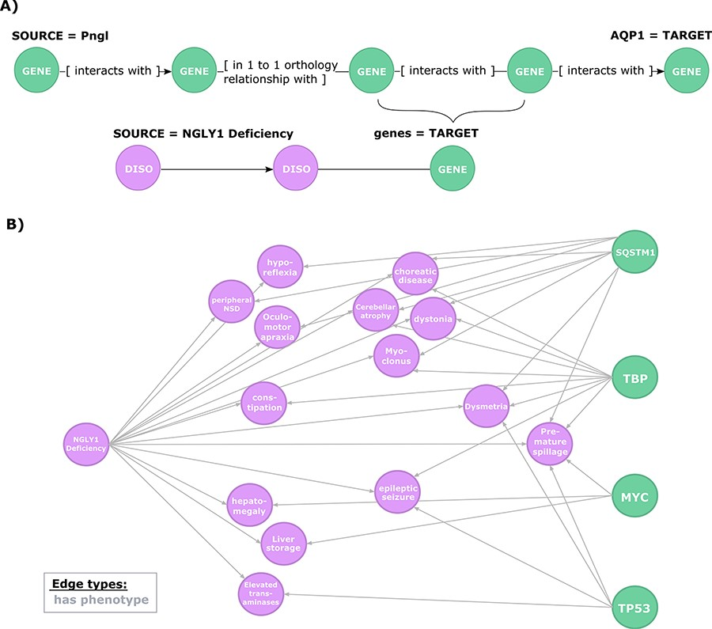
Figure 4 Exploration of the evidence relating candidate regulators of AQP1 to NGLY1 Deficiency phenotypes. (A) Second ...
Notes:
Figure 4 Exploration of the evidence relating candidate regulators of AQP1 to NGLY1 Deficiency phenotypes. (A) Second query topology for the AQP1 regulation-disease phenotypes shared genetic basis hypothesis. (B) Hypotheses resulted from the second query. All edges are of type ‘has phenotype’.
Unless provided in the caption above, the following copyright applies to the content of this slide: © The Author(s) 2020. Published by Oxford University Press.This is an Open Access article distributed under the terms of the Creative Commons Attribution License (http://creativecommons.org/licenses/by/4.0/), which permits unrestricted reuse, distribution, and reproduction in any medium, provided the original work is properly cited.

