Slide 1
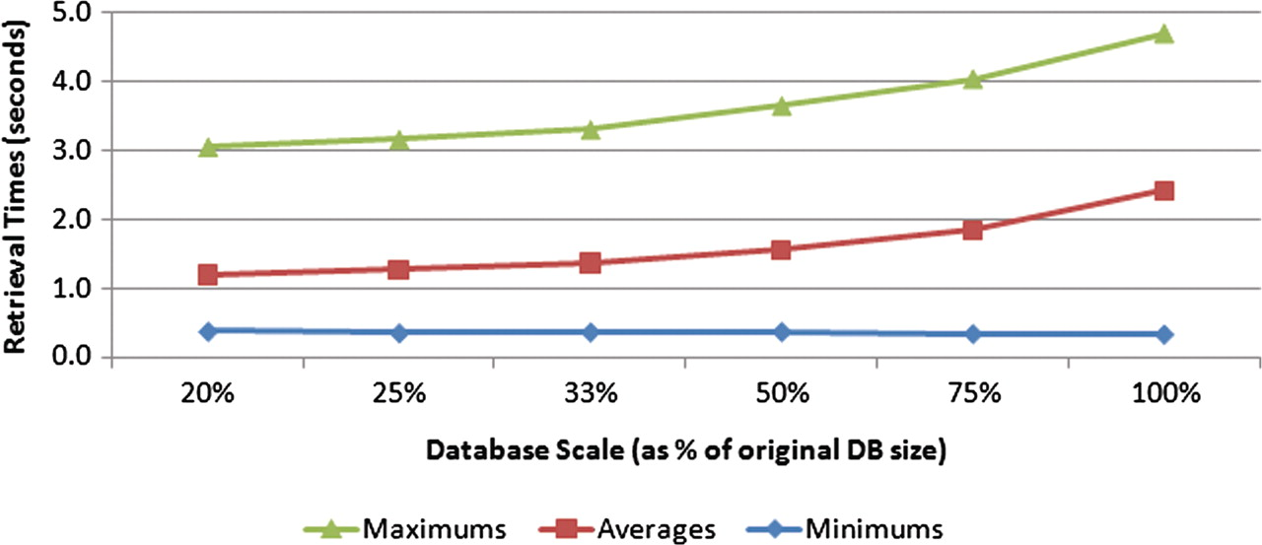
Figure 10. Effect of database size on retrieval speeds. Six different-sized test databases were constructed from subsets ...
Notes:
Figure 10. Effect of database size on retrieval speeds. Six different-sized test databases were constructed from subsets of the original data set. All the test queries were executed against each of these test databases, with the minimum, average and maximum query times measured. The trend suggests a nonlinear complexity for the search task.
Unless provided in the caption above, the following copyright applies to the content of this slide: © The Author(s) 2011. Published by Oxford University Press.This is Open Access article distributed under the terms of the Creative Commons Attribution Non-Commercial License (http://creativecommons.org/licenses/by-nc/2.5), which permits unrestricted non-commercial use, distribution, and reproduction in any medium, provided the original work is properly cited.

