Slide 1
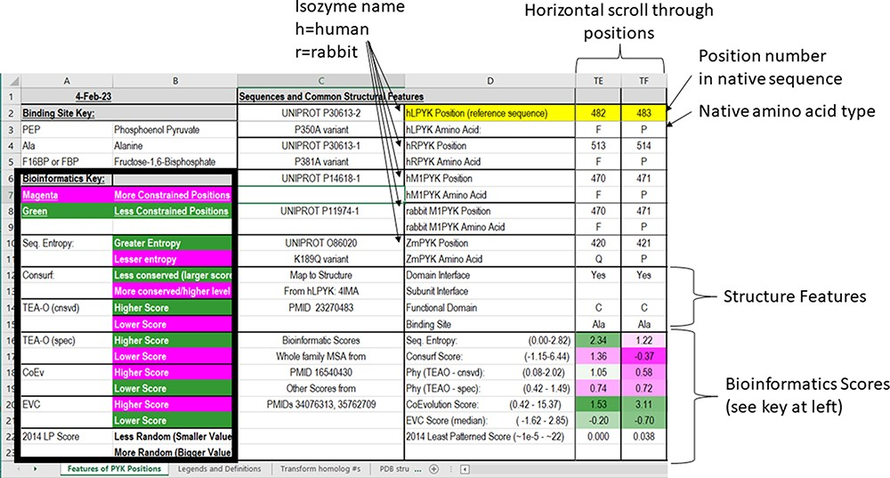
Figure 3. The top two sections of the ‘Features of PYK Positions’ page from PYK-SubstitutionOME. The left-most rows ...
Notes:
Figure 3. The top two sections of the ‘Features of PYK Positions’ page from PYK-SubstitutionOME. The left-most rows contain reference information and abbreviations. The top rows (1–11) contain the position numbers and wild-type amino acids for hLPYK, hRPYK, hM1PYK, rM1PYK and ZmPYK. Note that Columns A–D are locked, allowing the position columns to be scrolled. The next section’s rows (12–23) include notes on the structural locations for each position and evolutionary scores derived from the MSAs in Unit 2 (9, 17, 136). Each evolutionary score type has a different range, which is indicated in parentheses by the score names. To aid interpretation, the scores for each position are colored to show where it falls in the range, with magenta indicating stronger constraint/more prevalent pattern and green indicating less (see the legend highlighted with the black box on the left of this figure) .
Unless provided in the caption above, the following copyright applies to the content of this slide: © The Author(s) 2023. Published by Oxford University Press.This is an Open Access article distributed under the terms of the Creative Commons Attribution License (https://creativecommons.org/licenses/by/4.0/), which permits unrestricted reuse, distribution, and reproduction in any medium, provided the original work is properly cited.

