Slide 1
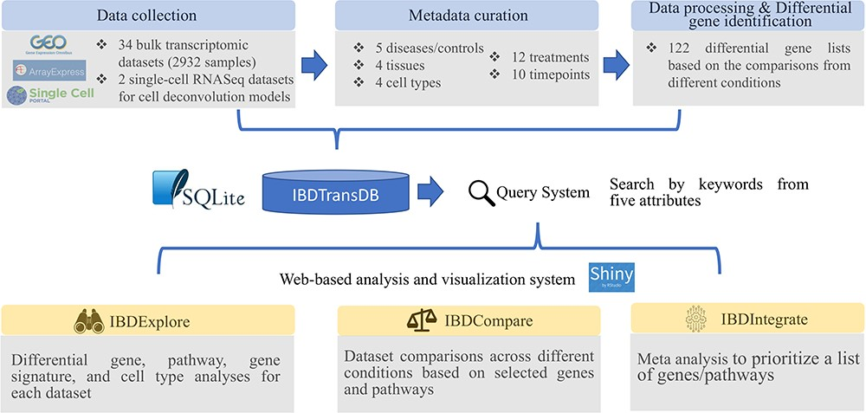
Figure 1. IBDTransDB for exploratory, comparative and integrative datasets to identify and validate the novel IBD ...
Notes:
Figure 1. IBDTransDB for exploratory, comparative and integrative datasets to identify and validate the novel IBD targets. Top panel: data processing and meta data curation for 34 IBD bulk transcriptomics datasets and 2 single-cell RNASeq datasets. Bottom panel: three data analysis modules.
Unless provided in the caption above, the following copyright applies to the content of this slide: © The Author(s) 2024. Published by Oxford University Press.This is an Open Access article distributed under the terms of the Creative Commons Attribution License (https://creativecommons.org/licenses/by/4.0/), which permits unrestricted reuse, distribution, and reproduction in any medium, provided the original work is properly cited.

