Slide 1
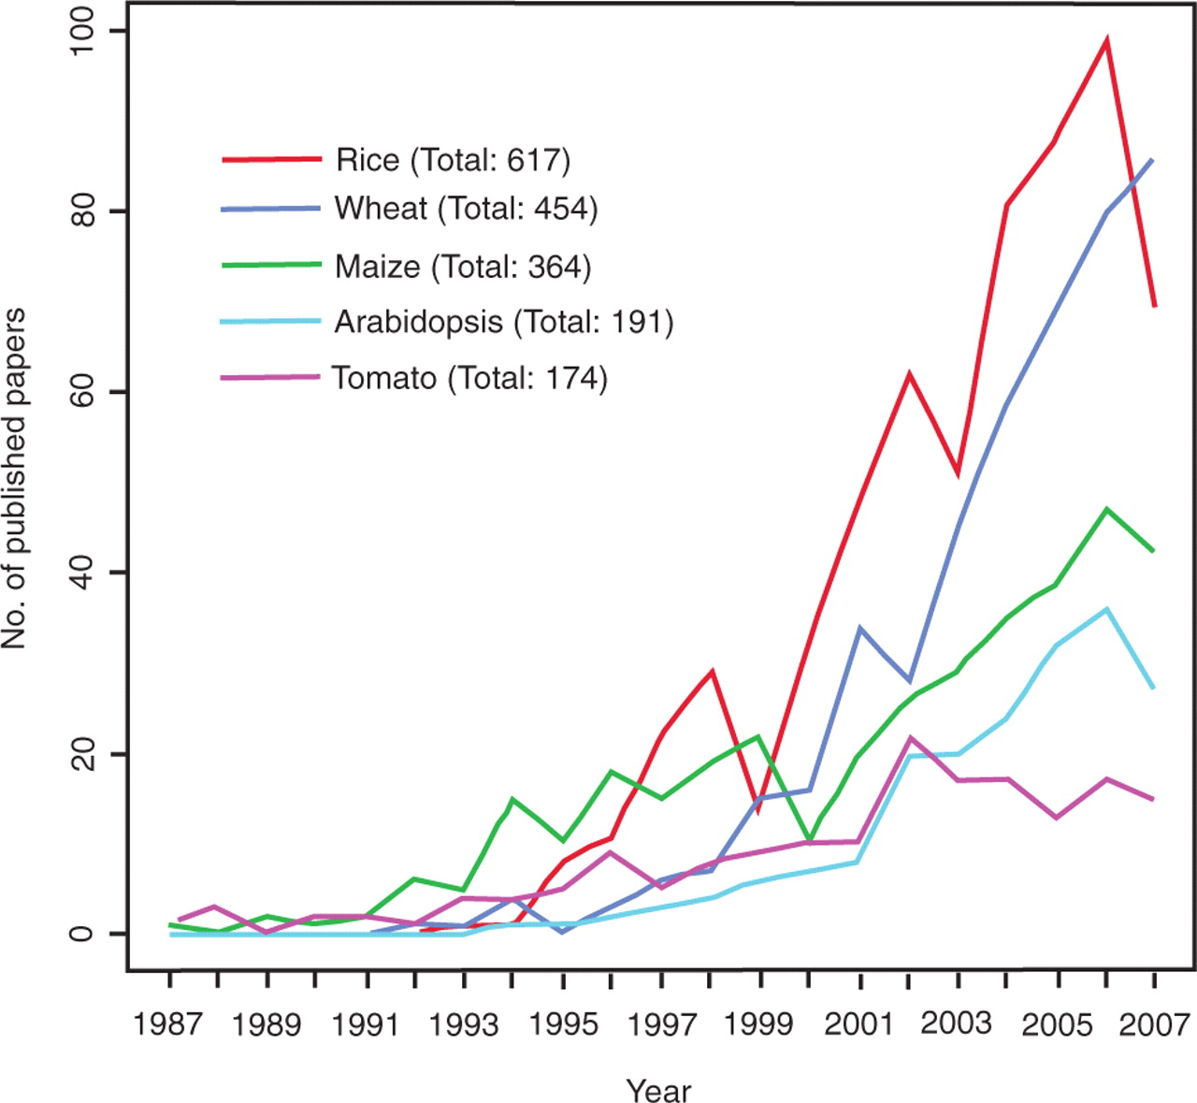
Figure 1. Number of published QTL papers for rice, wheat, maize, Arabidopsis and tomato between 1987 and 2007. Graph ...
Notes:
Figure 1. Number of published QTL papers for rice, wheat, maize, Arabidopsis and tomato between 1987 and 2007. Graph showing the steady increase in publications reporting QTLs in five major plant species between 1987 and 2007 based on nonredundant data from four publicly available literature databases, PubMed, Agricola, CAB Abstracts and BIOSIS Previews.
Unless provided in the caption above, the following copyright applies to the content of this slide: © 2009 The Author(s).This is Open Access article distributed under the terms of the Creative Commons Attribution Non-Commercial License (http://creativecommons.org/licenses/by-nc/2.0/uk/) which permits unrestricted non-commercial use, distribution, and reproduction in any medium, provided the original work is properly cited.

