Slide 1
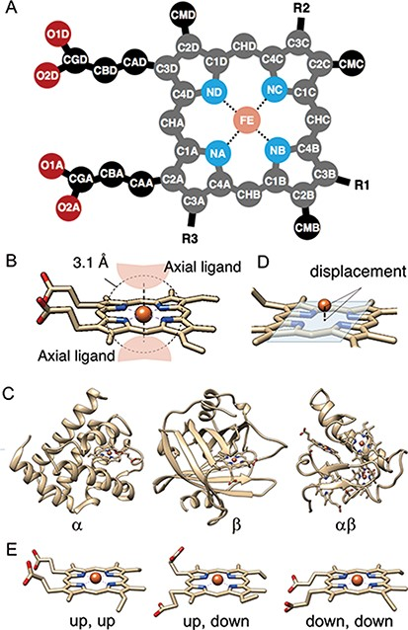
Figure 3. (A) The atomic nomenclature in heme. Twenty-five atoms of Fe-porphyrin (shown in lighter colors: grey, cyan ...
Notes:
Figure 3. (A) The atomic nomenclature in heme. Twenty-five atoms of Fe-porphyrin (shown in lighter colors: grey, cyan and orange) represent the porphyrin skeleton. (B) Identification of the axial ligand(s) of heme. The amino acids or other small molecules within 3.1 Å of the FE atom were identified as the axial ligands. (C) Representative structures of each protein fold in CATH level C (1: α, 2: β and 3: αβ). (D) The out-of-plane displacement of the iron ion from the least square fit plane of the 4 nitrogen atoms (NA, NB, NC and ND). (E) Schematic diagrams of the orientations of the propionate sidechains.
Unless provided in the caption above, the following copyright applies to the content of this slide: © The Author(s) 2020. Published by Oxford University Press.This is an Open Access article distributed under the terms of the Creative Commons Attribution License (http://creativecommons.org/licenses/by/4.0/), which permits unrestricted reuse, distribution, and reproduction in any medium, provided the original work is properly cited.

