Slide 1
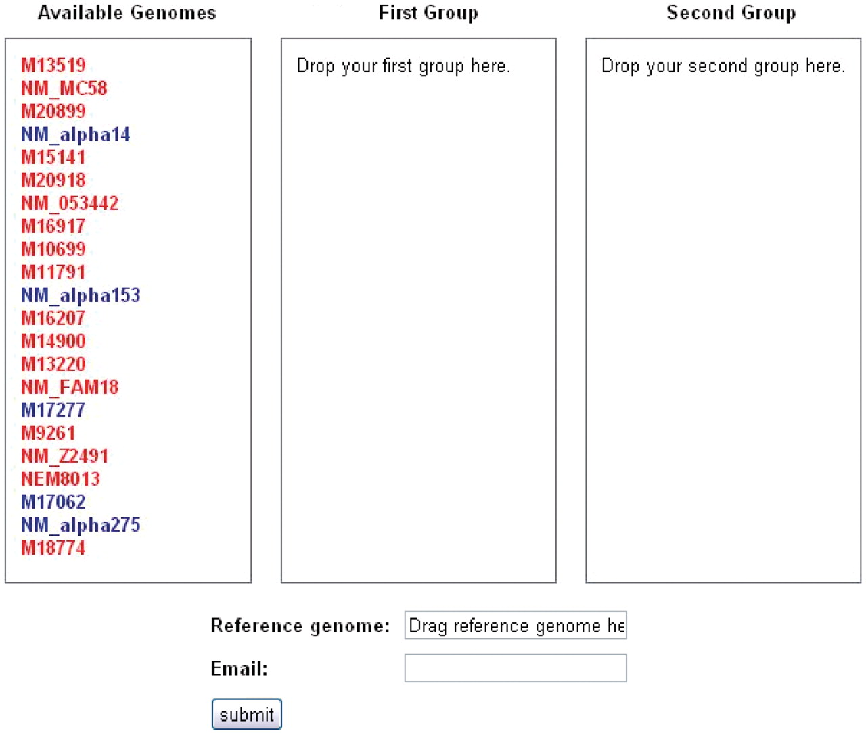
Figure 2. SNPtool. The SNPtool finds discriminating SNPs between two groups of genomes. Each group is defined by the ...
Notes:
Figure 2. SNPtool. The SNPtool finds discriminating SNPs between two groups of genomes. Each group is defined by the user, by dragging each genome to a designated group. Not all genomes must be used. A reference genome must be designated, as the results can be viewed on the graphical genome browser from the vantage point of the chosen reference genome. Invasive isolates are designated by red, carriage by blue.
Unless provided in the caption above, the following copyright applies to the content of this slide: © The Author(s) 2011. Published by Oxford University Press.This is Open Access article distributed under the terms of the Creative Commons Attribution Non-Commercial License (http://creativecommons.org/licenses/by-nc/2.5), which permits unrestricted non-commercial use, distribution, and reproduction in any medium, provided the original work is properly cited.

