Slide 1
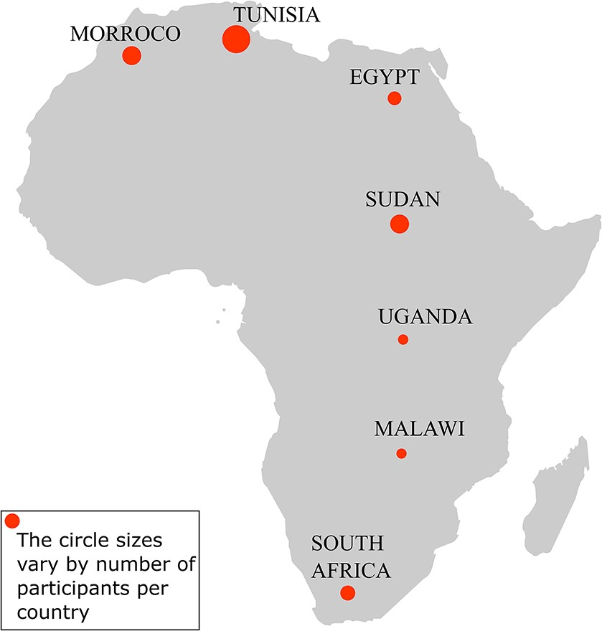
Figure 1. Participants’ representation by country in the hackathon. The hackathon involved 24 participants from seven ...
Notes:
Figure 1. Participants’ representation by country in the hackathon. The hackathon involved 24 participants from seven African countries: Tunisia (8), Morocco (4), Sudan (4), South Africa (3), Egypt (3), Uganda (1) and Malawi (1).
Unless provided in the caption above, the following copyright applies to the content of this slide: © The Author(s) 2021. Published by Oxford University Press.This is an Open Access article distributed under the terms of the Creative Commons Attribution License (http://creativecommons.org/licenses/by/4.0/), which permits unrestricted reuse, distribution, and reproduction in any medium, provided the original work is properly cited.

