Slide 1
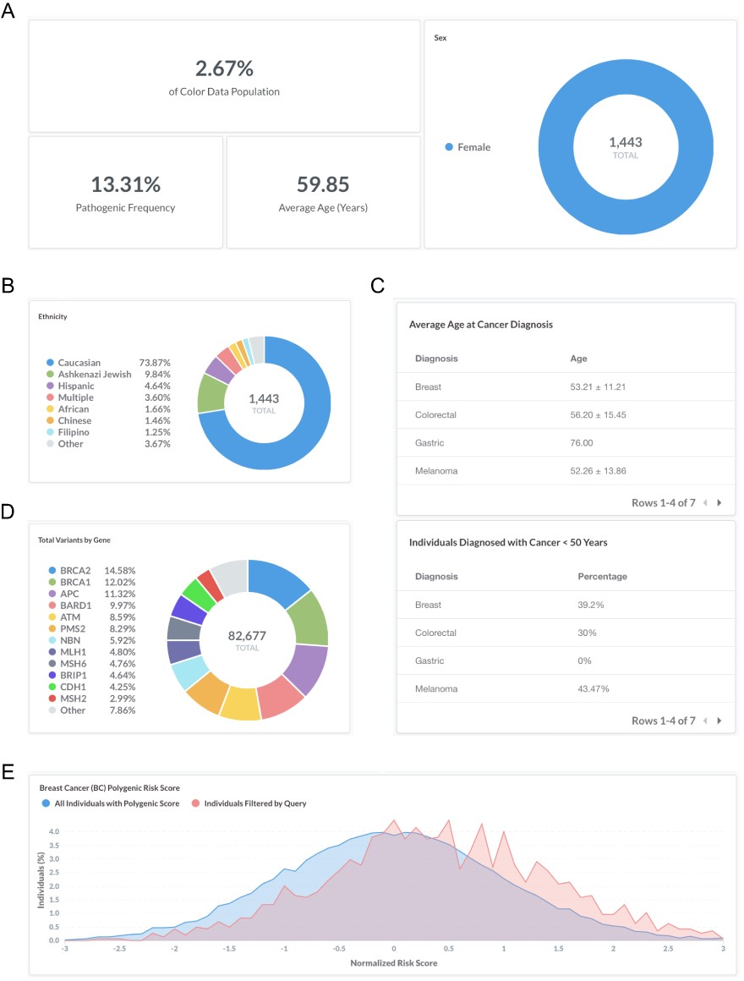
Figure 2. Screenshots of query results for monogenic and polygenic breast cancer risk in women with a personal history ...
Notes:
Figure 2. Screenshots of query results for monogenic and polygenic breast cancer risk in women with a personal history of breast cancer. (A–E) Filter by ‘Sex: Female’, ‘Personal health history: Breast’ and ‘BC Polygenic Risk Score: Calculated’. Query URL: https://data.color.com/v2/cancer.html#sex=Female&personal_health_history=Breast&bc_polygenic_risk_score=Calculated.
Unless provided in the caption above, the following copyright applies to the content of this slide: © The Author(s) 2020. Published by Oxford University Press.This is an Open Access article distributed under the terms of the Creative Commons Attribution License (http://creativecommons.org/licenses/by/4.0/), which permits unrestricted reuse, distribution, and reproduction in any medium, provided the original work is properly cited.

