Slide 1
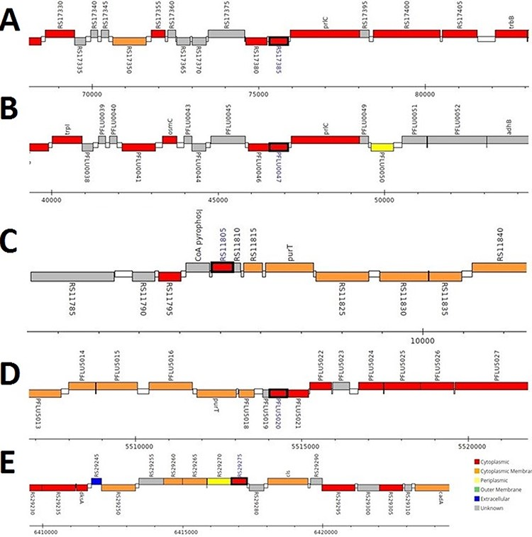
Figure 3. Genomic analysis of γ-CA sequences from putative contaminants associated with Pseudomonas spp. The analysis ...
Notes:
Figure 3. Genomic analysis of γ-CA sequences from putative contaminants associated with Pseudomonas spp. The analysis shows the presence of coding genes for γ-CA from (A) Pseudomonas sp. LP_8_YM (UniProt ID: A0A4R3W1J2), (B) Pseudomonas fluorescens (UniProt ID: A0A125QD08), (C) Pseudomonas sp. LP_8_YM (UniProt ID: A0A4R3W9L6), (D) Pseudomonas fluorescens (UniProt ID: A0A2N1E8I6) and (E) Pseudomonas synxantha (UniProt ID: A0A419V156).
Unless provided in the caption above, the following copyright applies to the content of this slide: © The Author(s) 2021. Published by Oxford University Press.This is an Open Access article distributed under the terms of the Creative Commons Attribution License (http://creativecommons.org/licenses/by/4.0/), which permits unrestricted reuse, distribution, and reproduction in any medium, provided the original work is properly cited.

