Slide 1
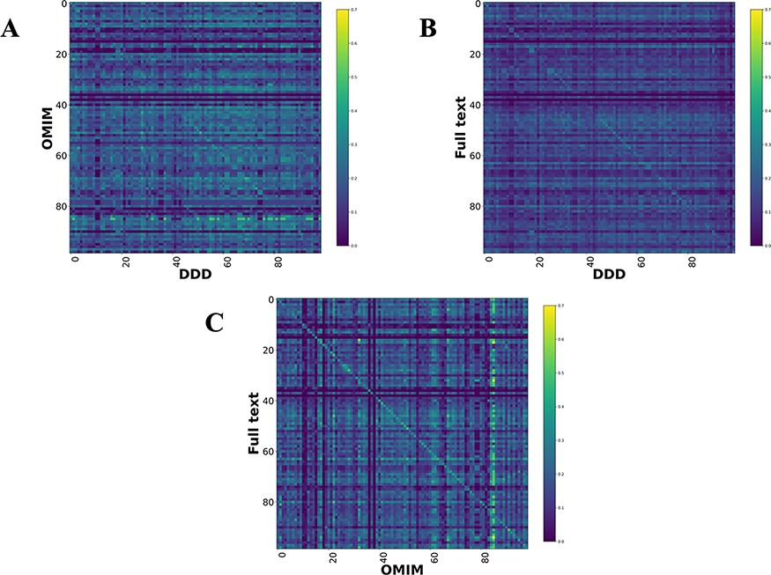
Figure 4. Disease model comparison heatmaps using RBO for literature-, OMIM- and DDD-derived models. Each model on the ...
Notes:
Figure 4. Disease model comparison heatmaps using RBO for literature-, OMIM- and DDD-derived models. Each model on the y-axis is compared with every model in the DDD set. Disease/DDD models describing the same disorder are on the rightward slanting diagonal. (A) compares OMIM and DDD models. (B) compares literature-derived and DDD models. (C) compares literature-derived and OMIM models. 99 diseases in comparison set.
Unless provided in the caption above, the following copyright applies to the content of this slide: © The Author(s) 2022. Published by Oxford University Press.This is an Open Access article distributed under the terms of the Creative Commons Attribution-NonCommercial License (https://creativecommons.org/licenses/by-nc/4.0/), which permits non-commercial re-use, distribution, and reproduction in any medium, provided the original work is properly cited. For commercial re-use, please contact journals.permissions@oup.com

