Slide 1
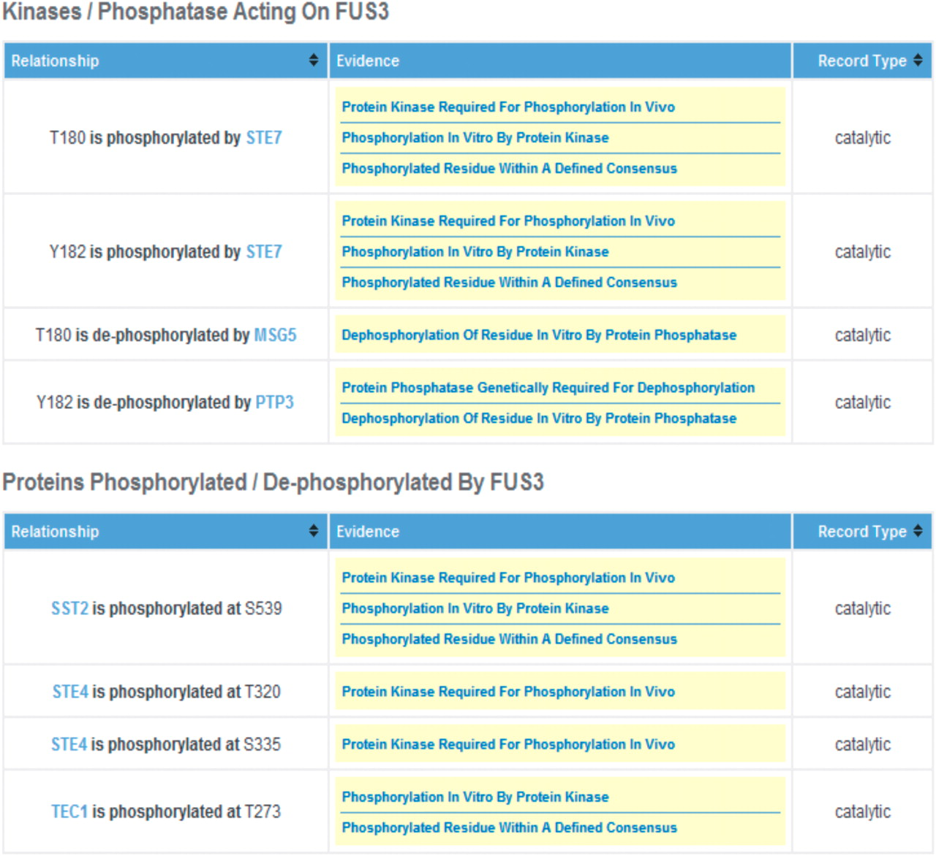
Figure 2. Screen shot of the Fus3 PhosphoGRID page. Details of relationships between phosphorylated residues and ...
Notes:
Figure 2. Screen shot of the Fus3 PhosphoGRID page. Details of relationships between phosphorylated residues and specific protein kinases and phosphatases are displayed in a second table for each gene product. Additionally, for protein kinases and phosphatases themselves, a summary of known substrate sites, with links to the relevant gene product is presented in an additional table (not shown).
Unless provided in the caption above, the following copyright applies to the content of this slide: © The Author(s) 2010. Published by Oxford University Press.This is Open Access article distributed under the terms of the Creative Commons Attribution Non-Commercial License (http://creativecommons.org/licenses/by-nc/2.5), which permits unrestricted non-commercial use, distribution, and reproduction in any medium, provided the original work is properly cited.

