Slide 1
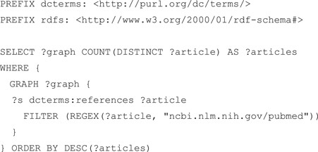
Figure 5 SPARQL query that counts the references in each RDF graph. According to guideline 4, all datasets refer to ...
Notes:
Figure 5 SPARQL query that counts the references in each RDF graph. According to guideline 4, all datasets refer to the PubMed literature using the dcterms:references property.
Unless provided in the caption above, the following copyright applies to the content of this slide: © The Author(s) 2018. Published by Oxford University Press. All rights reserved. For Permissions, please email: journals.permissions@oup.comThis article is published and distributed under the terms of the Oxford University Press, Standard Journals Publication Model (https://academic.oup.com/journals/pages/open_access/funder_policies/chorus/standard_publication_model)

