Slide 1
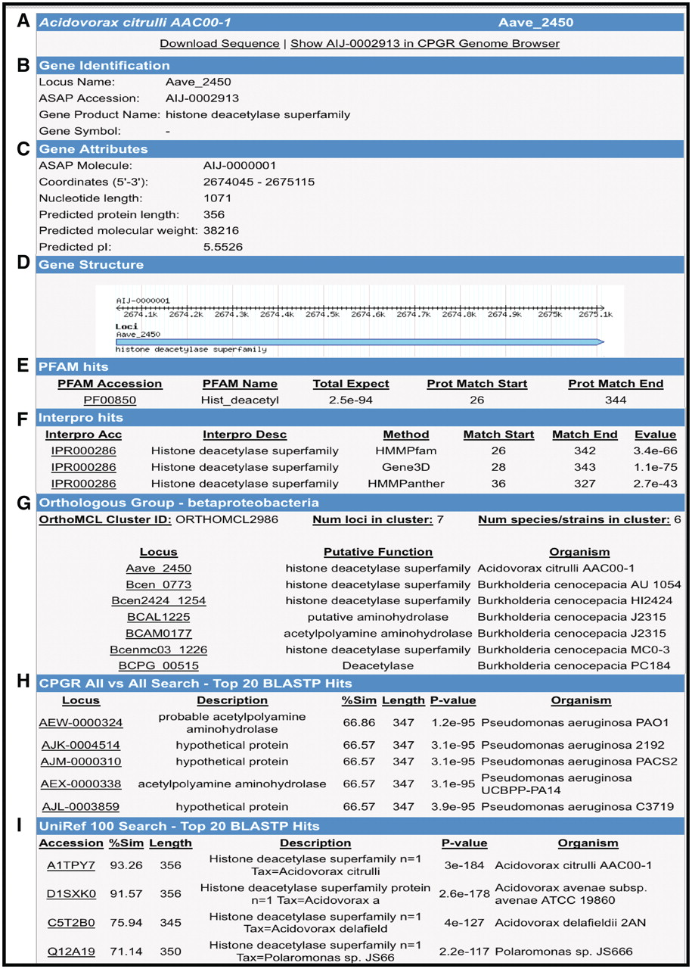
Figure 4. Gene Report Page for Acidovorax avenae subsp. citrulli AAC00-1 Aave_2450. (A) Hyperlinks to download gene ...
Notes:
Figure 4. Gene Report Page for Acidovorax avenae subsp. citrulli AAC00-1 Aave_2450. (A) Hyperlinks to download gene sequence and genome browser display of the locus. (B) Locus name, functional annotation and gene name (if available). (C) Gene attributes including molecule location (chromosome, plasmid), coordinates and protein metrics. (D) Gene structure. (E) Pfam domain matches with scores. (F) InterPro hits including position of matches and E-value. (G) Orthologous groups from β-Proteobacteria clustering. (H) BLASTP search results from an all versus search of bacterial proteins within the CPGR. (I) Partial listing of UniRef100 top matches.
Unless provided in the caption above, the following copyright applies to the content of this slide: © The Author(s) 2011. Published by Oxford University Press.This is an Open Access article distributed under the terms of the Creative Commons Attribution Non-Commercial License (http://creativecommons.org/licenses/by-nc/3.0), which permits unrestricted non-commercial use, distribution, and reproduction in any medium, provided the original work is properly cited.

