Slide 1
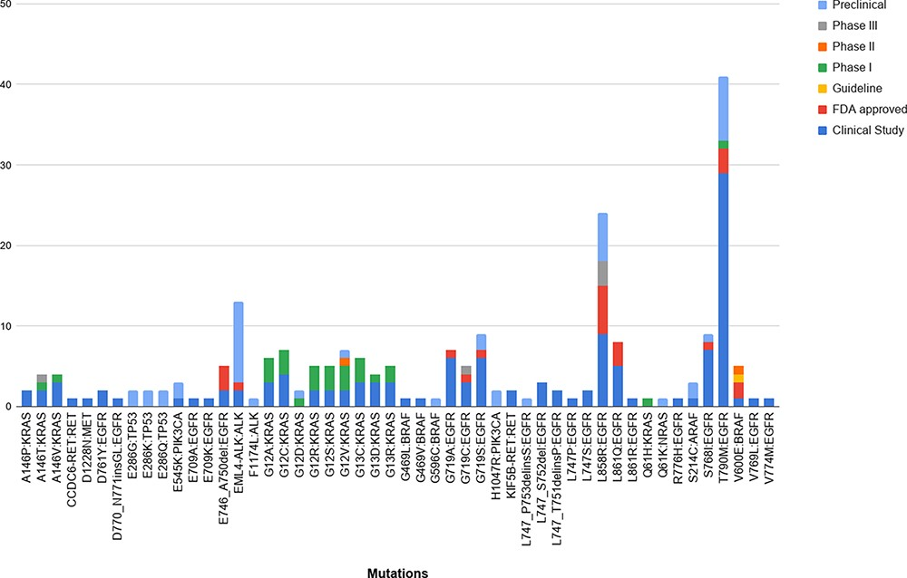
Figure 6. The breakdown of the 50 unique variants overlapping between the patient dataset and MUSTARD, according to ...
Notes:
Figure 6. The breakdown of the 50 unique variants overlapping between the patient dataset and MUSTARD, according to their stage of study as per the database annotations.
Unless provided in the caption above, the following copyright applies to the content of this slide: © The Author(s) 2021. Published by Oxford University Press.This is an Open Access article distributed under the terms of the Creative Commons Attribution License (http://creativecommons.org/licenses/by/4.0/), which permits unrestricted reuse, distribution, and reproduction in any medium, provided the original work is properly cited.

