Slide 1
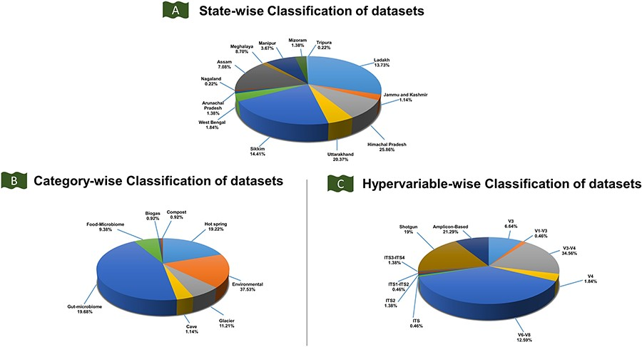
Figure 4. Classification of the IHM-DB. (A) State-wise classification of datasets defines the percentage share of ...
Notes:
Figure 4. Classification of the IHM-DB. (A) State-wise classification of datasets defines the percentage share of datasets for 13 IHR states. (B) The percentage share for category-wise datasets. The datasets are divided into six categories: food microbiome, gut microbiome, hot spring, cave, environmental, and glacier. (C) The percentage share for hypervariable-wise data. The hypervariable dataset is classified into 11 categories based on shotgun and amplicon-based sequences.
Unless provided in the caption above, the following copyright applies to the content of this slide: © The Author(s) 2023. Published by Oxford University Press.This is an Open Access article distributed under the terms of the Creative Commons Attribution License (https://creativecommons.org/licenses/by/4.0/), which permits unrestricted reuse, distribution, and reproduction in any medium, provided the original work is properly cited.

