Slide 1
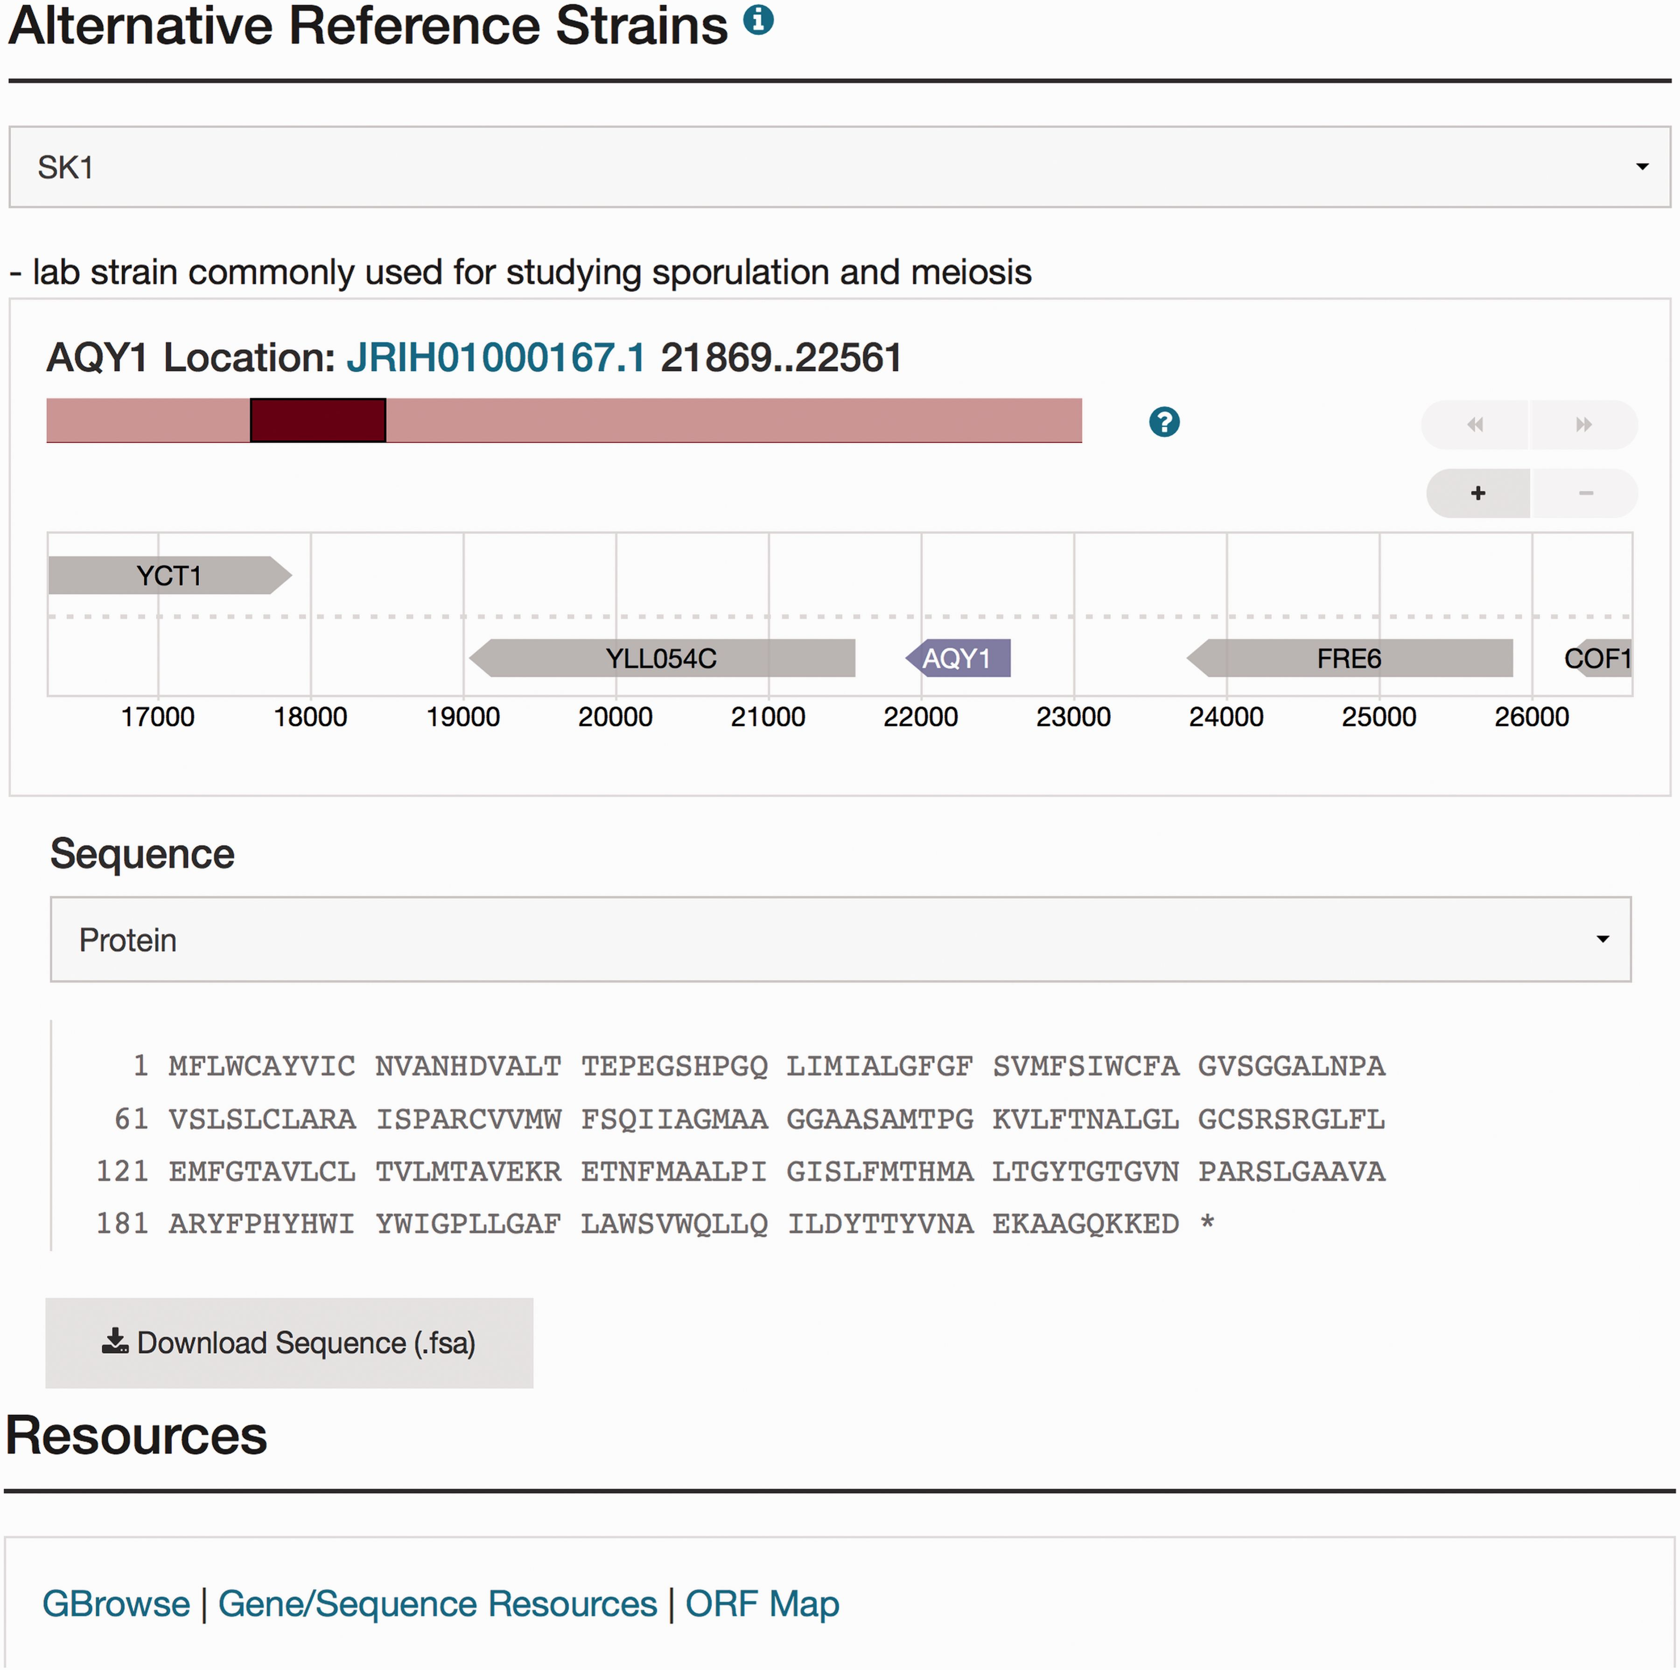
Figure 1. Visualization of the new sequence data for AQY1 in the database. The Sequence page can be accessed by ...
Notes:
Figure 1. Visualization of the new sequence data for AQY1 in the database. The Sequence page can be accessed by selecting the tab at the top of the AQY1 LSP, labeled ‘Sequence.’ There are six sections within the Sequence page including the ‘Sequence Overview’ for descriptive information, ‘Alternative Reference Strains’ for viewing the DNA or protein sequence in a selected alternative reference strain, and ‘Resources’ for access to processed results using sequence analysis tools (e.g. a new tool called SGD Variant Viewer ( 28 ), updated BLAST search, and ClustalW multiple sequence alignments). Selection of SK1 as an alternative strain is illustrated in this figure. Neighbor genes of AQY1 in SK1 are also shown in the visualization. When the user clicks a sequence analysis tool (URL in blue) in the resources tab, they will view the gene-specific results using that tool.
Unless provided in the caption above, the following copyright applies to the content of this slide: © The Author(s) 2016. Published by Oxford University Press. This is an Open Access article distributed under the terms of the Creative Commons Attribution License ( http://creativecommons.org/licenses/by/4.0/ ), which permits unrestricted reuse, distribution, and reproduction in any medium, provided the original work is properly cited.

