Slide 1
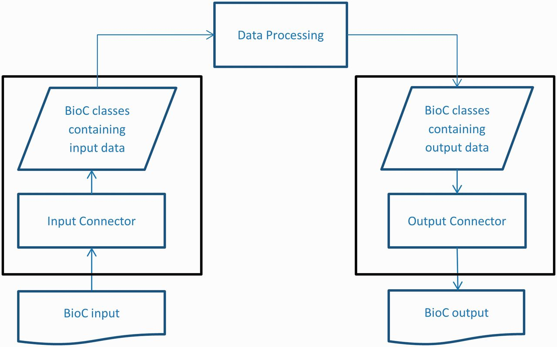
Figure 1. BioC workflow diagram.
Notes:
Figure 1. BioC workflow diagram.
Unless provided in the caption above, the following copyright applies to the content of this slide: Published by Oxford University Press 2014. This work is written by US Government employees and is in the public domain in the US.

Slide 2
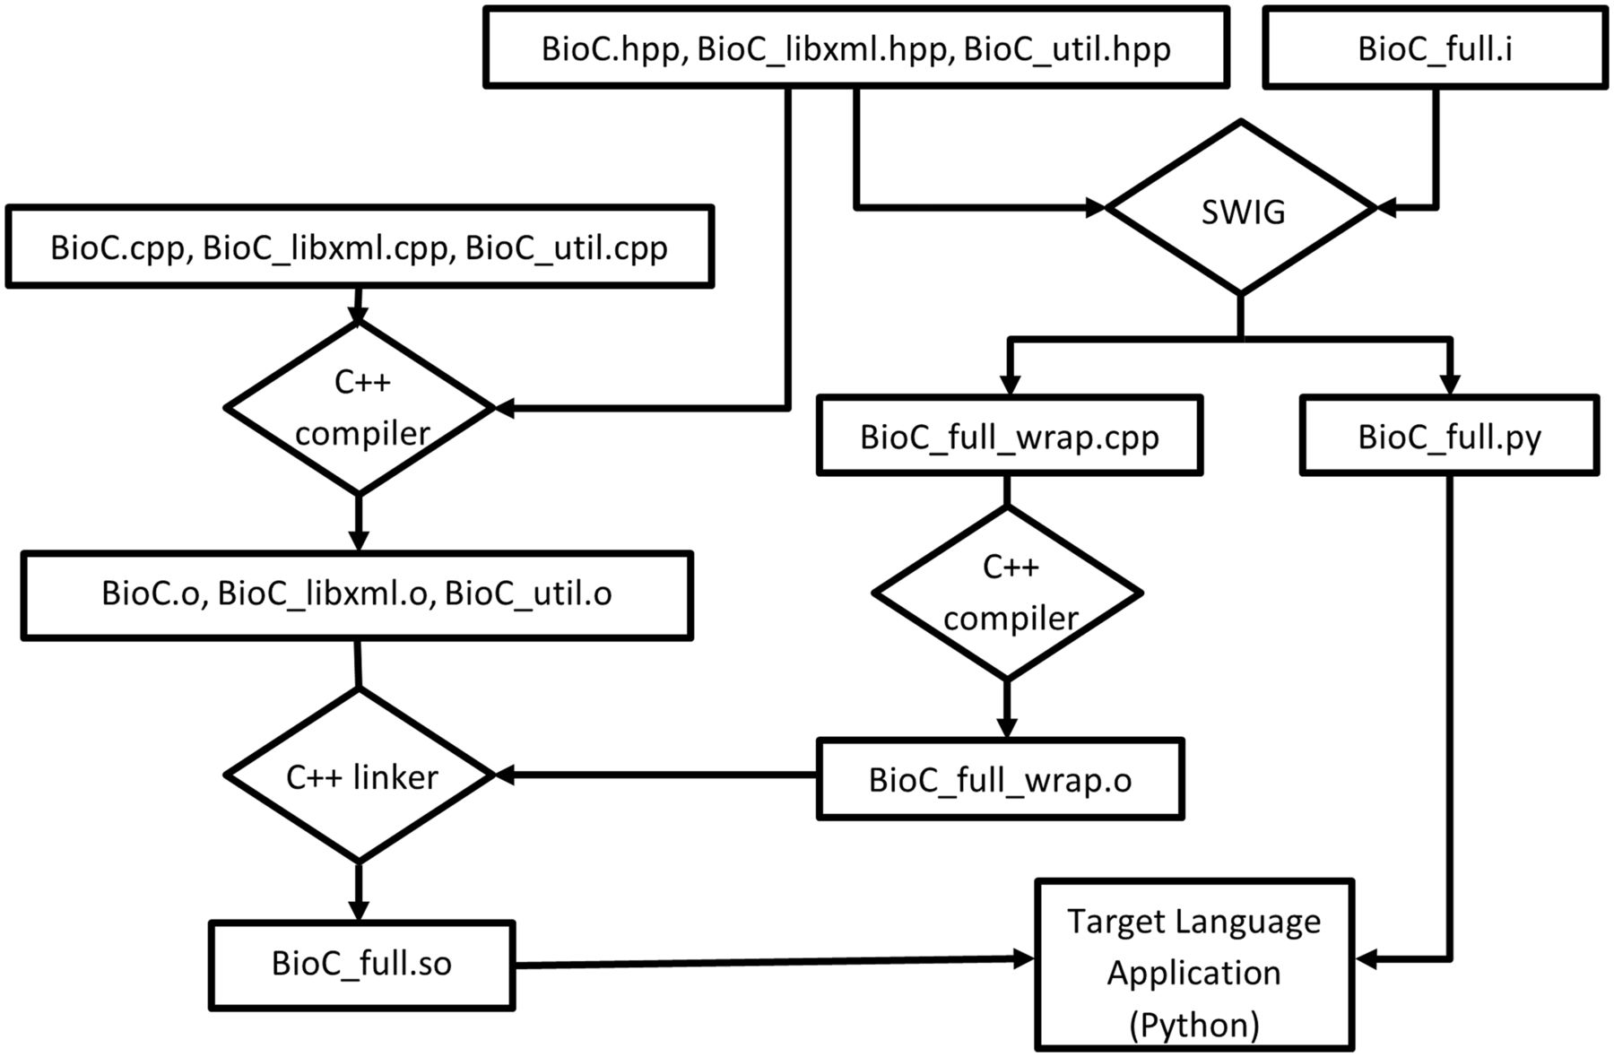
Figure 2. Building BioC modules with SWIG (for Python).
Notes:
Figure 2. Building BioC modules with SWIG (for Python).
Unless provided in the caption above, the following copyright applies to the content of this slide: Published by Oxford University Press 2014. This work is written by US Government employees and is in the public domain in the US.

Slide 3
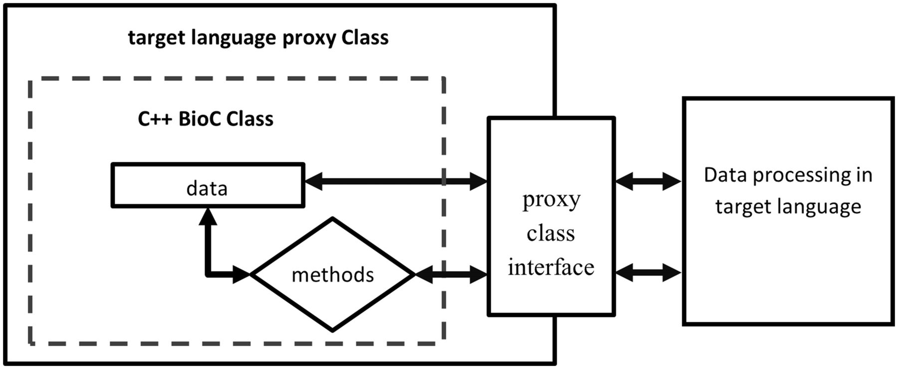
Figure 3. Access C++ BioC class through target language proxy class wrapper interface.
Notes:
Figure 3. Access C++ BioC class through target language proxy class wrapper interface.
Unless provided in the caption above, the following copyright applies to the content of this slide: Published by Oxford University Press 2014. This work is written by US Government employees and is in the public domain in the US.

Slide 4
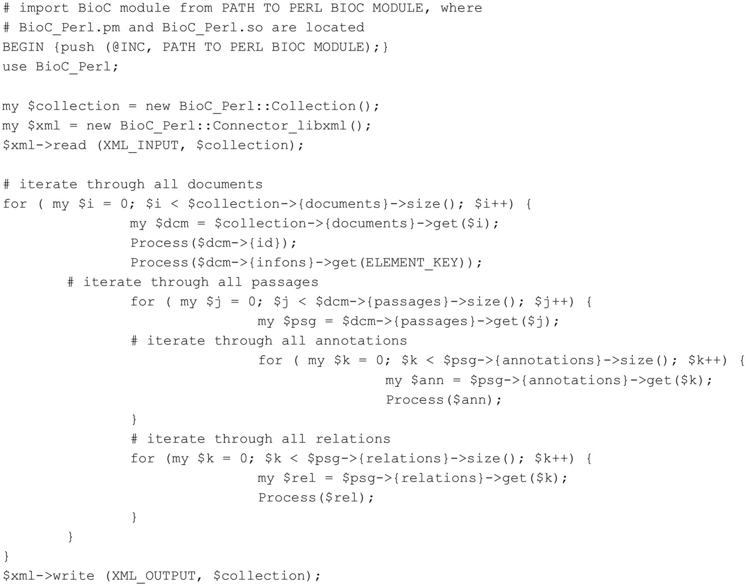
Figure 4. Perl code accessing BioC data (tested with Perl 5.8.8).
Notes:
Figure 4. Perl code accessing BioC data (tested with Perl 5.8.8).
Unless provided in the caption above, the following copyright applies to the content of this slide: Published by Oxford University Press 2014. This work is written by US Government employees and is in the public domain in the US.

Slide 5
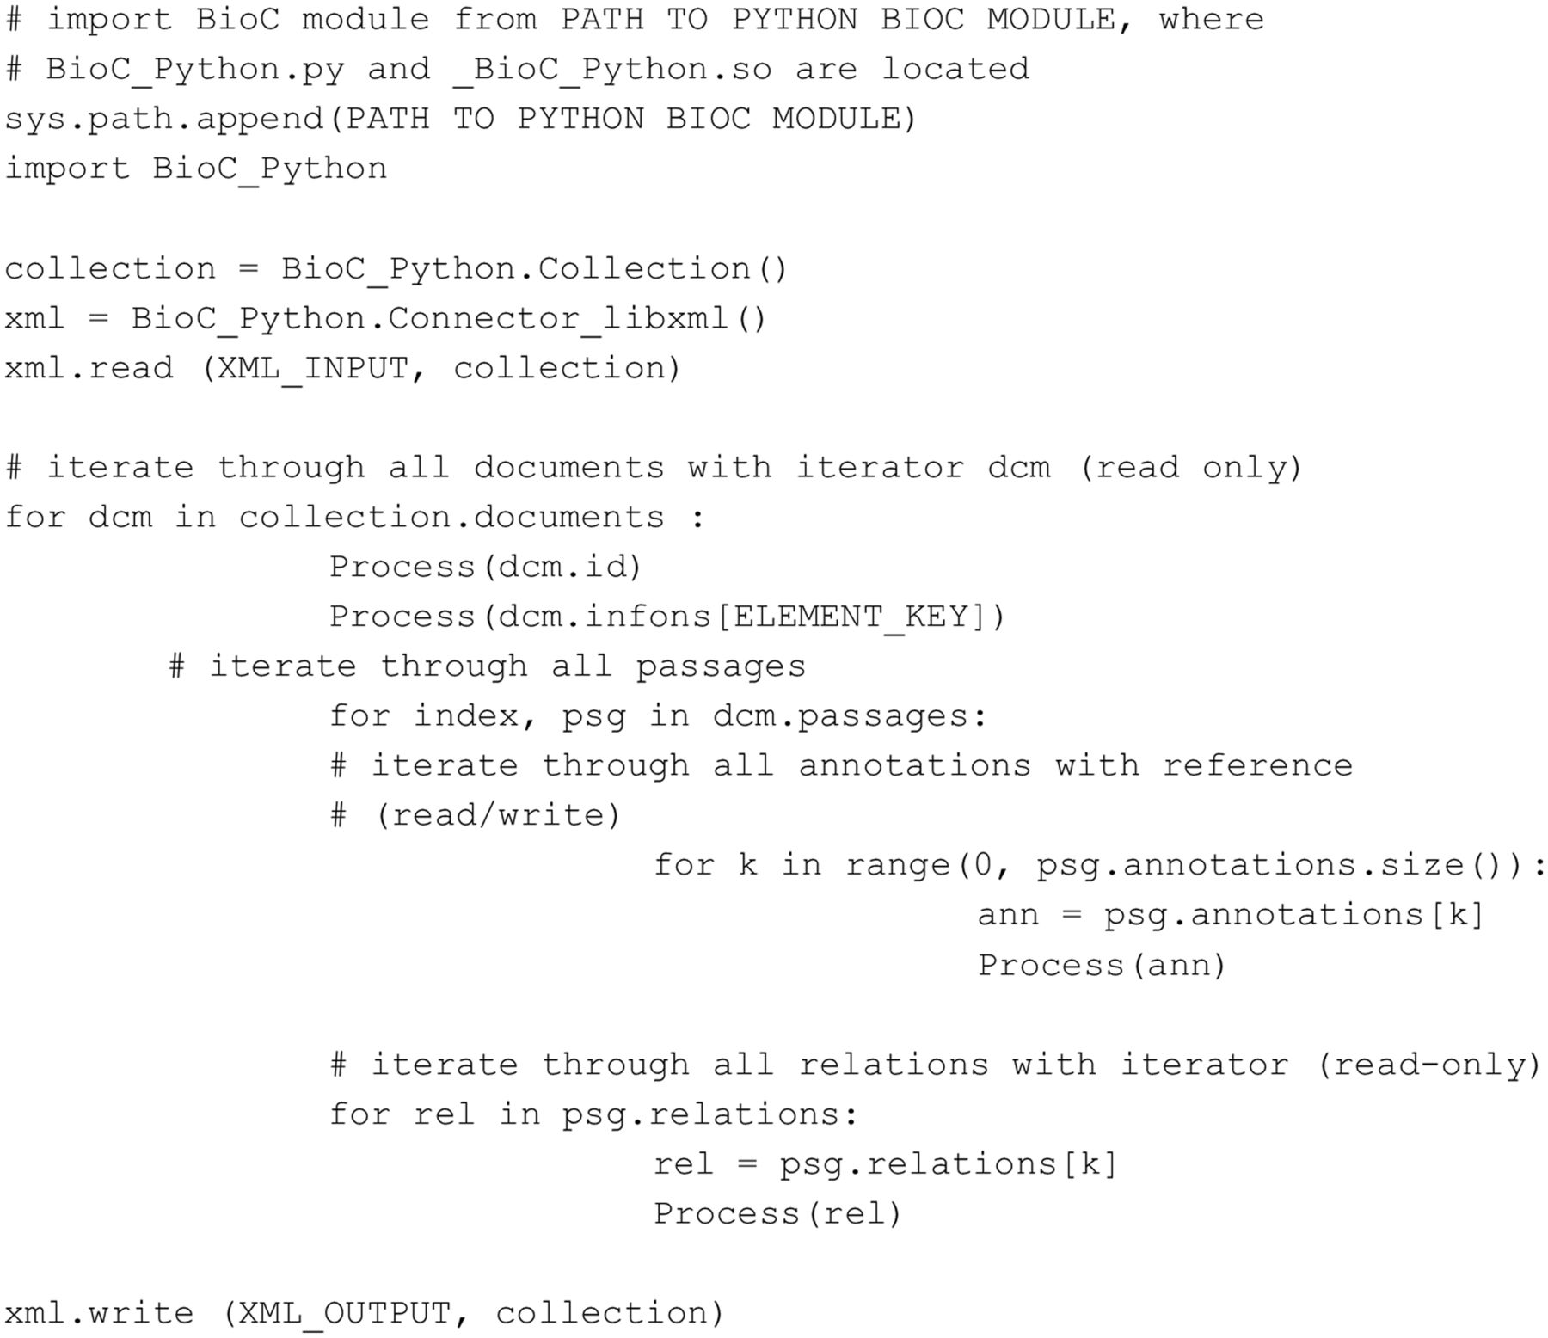
Figure 5. Python code accessing BioC data (tested with Python 2.5.1).
Notes:
Figure 5. Python code accessing BioC data (tested with Python 2.5.1).
Unless provided in the caption above, the following copyright applies to the content of this slide: Published by Oxford University Press 2014. This work is written by US Government employees and is in the public domain in the US.

Slide 6
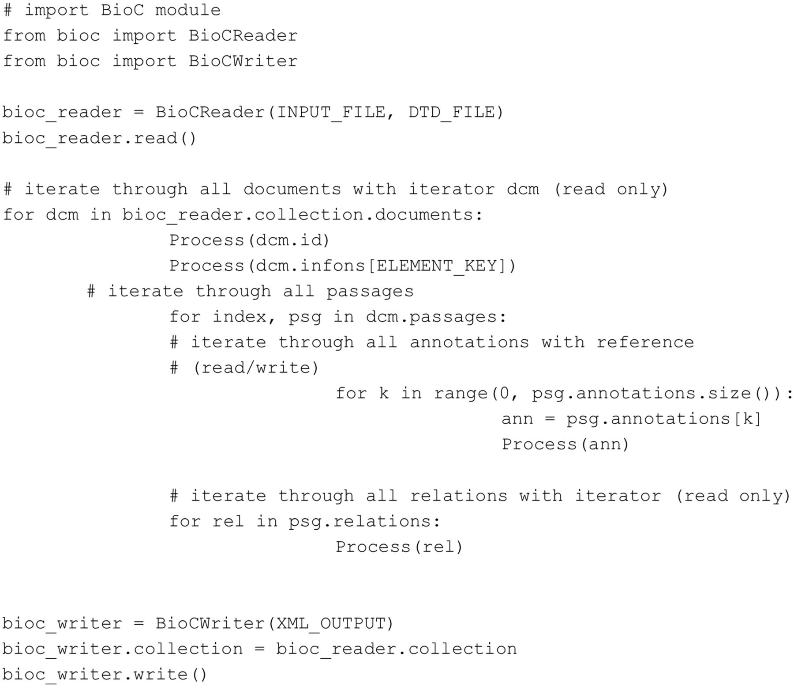
Figure 6. PyBioC code accessing BioC data.
Notes:
Figure 6. PyBioC code accessing BioC data.
Unless provided in the caption above, the following copyright applies to the content of this slide: Published by Oxford University Press 2014. This work is written by US Government employees and is in the public domain in the US.

Slide 7
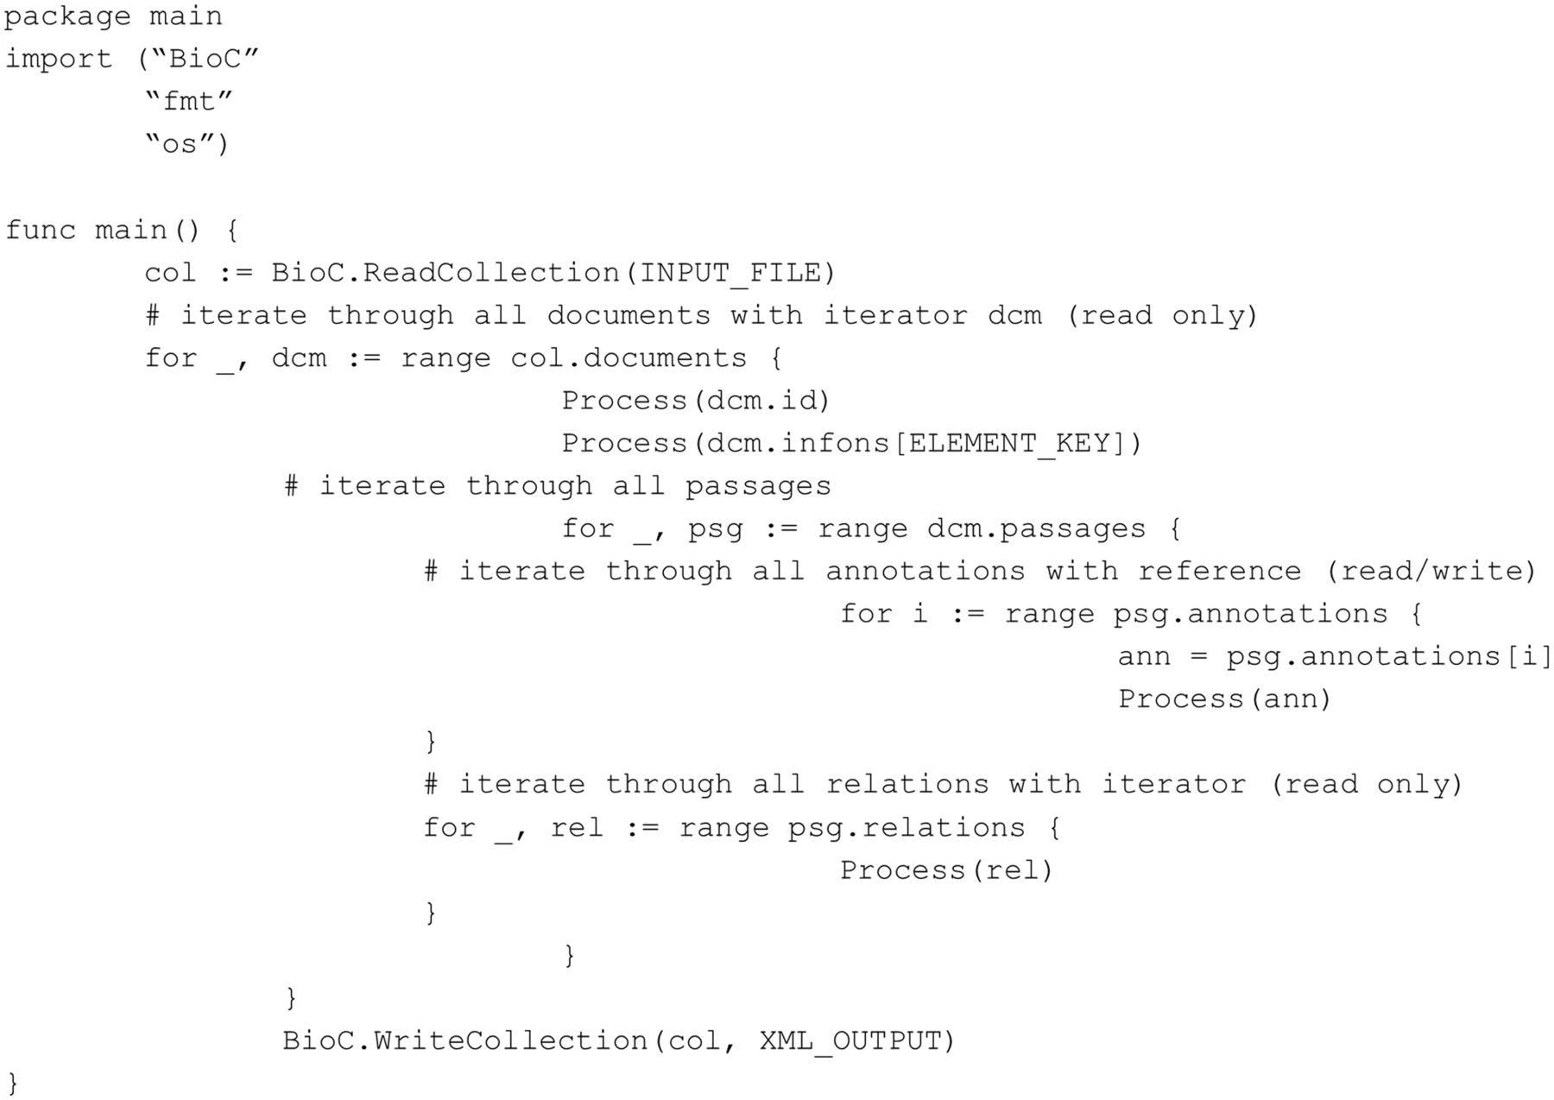
Figure 7. Go code accessing BioC data (tested with Go 1.1.2).
Notes:
Figure 7. Go code accessing BioC data (tested with Go 1.1.2).
Unless provided in the caption above, the following copyright applies to the content of this slide: Published by Oxford University Press 2014. This work is written by US Government employees and is in the public domain in the US.

Slide 8
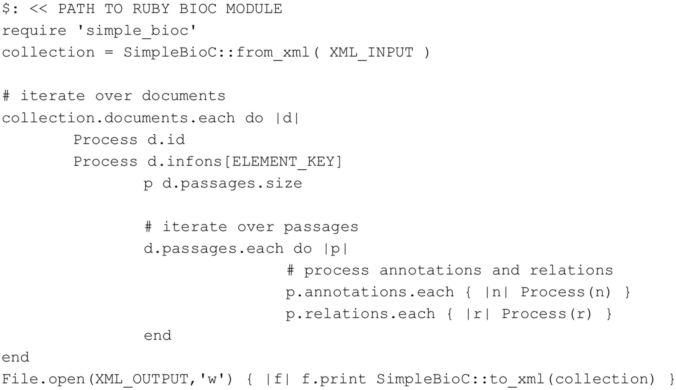
Figure 8. Ruby code accessing BioC data (tested with Ruby 2.0.0).
Notes:
Figure 8. Ruby code accessing BioC data (tested with Ruby 2.0.0).
Unless provided in the caption above, the following copyright applies to the content of this slide: Published by Oxford University Press 2014. This work is written by US Government employees and is in the public domain in the US.

