Slide 1
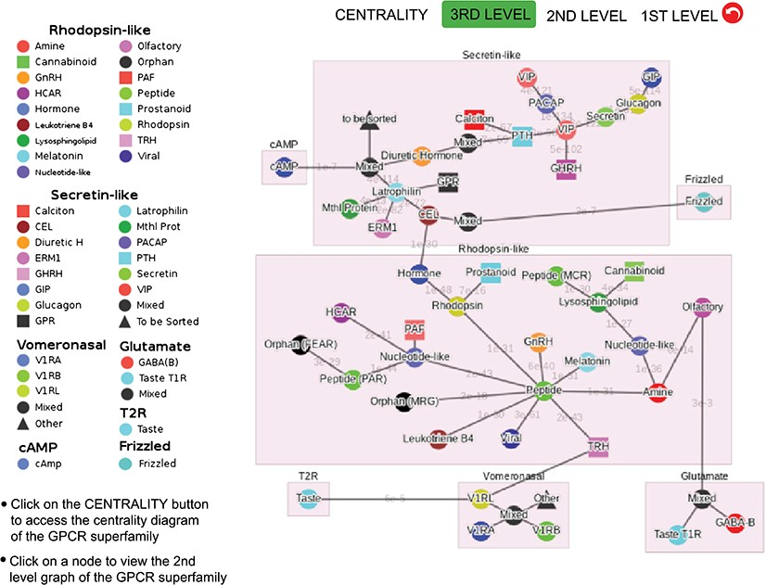
Figure 3 Third-level minimum spanning tree diagram of the GPCR superfamily with the base dataset. Each node represents ...
Notes:
Figure 3 Third-level minimum spanning tree diagram of the GPCR superfamily with the base dataset. Each node represents a GPCR family. The legend shows the scheme of nodes’ colors and shapes that is used to distinguish GPCR functions annotated in GPCRdb (also labeled on the nodes).
Unless provided in the caption above, the following copyright applies to the content of this slide: © The Author(s) 2019. Published by Oxford University Press.This is an Open Access article distributed under the terms of the Creative Commons Attribution License (http://creativecommons.org/licenses/by/4.0/), which permits unrestricted reuse, distribution, and reproduction in any medium, provided the original work is properly cited.

