Slide 1
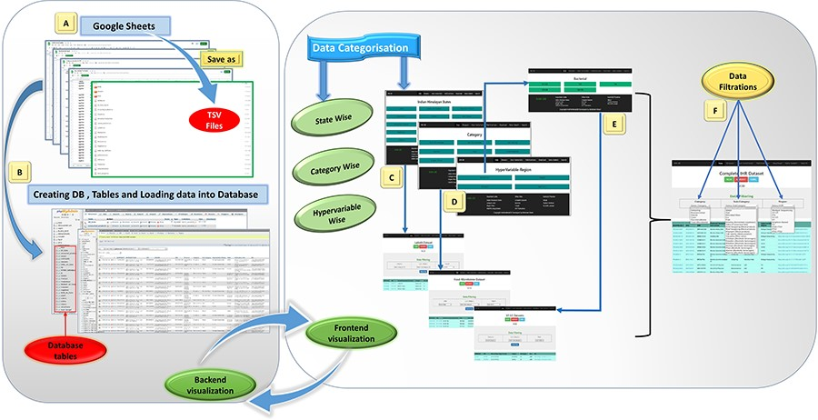
Figure 1. Database preparation, visualization, and workflow from back-end to front-end development of the IHM-DB. (A) ...
Notes:
Figure 1. Database preparation, visualization, and workflow from back-end to front-end development of the IHM-DB. (A) Collection of the dataset from publicly available databases. The dataset was manually collected from publicly available databases and stored in Google sheets (tsv files). (B) Creation of database tables in MySQL and loading of collected tsv files. (C–E) Web page visualization of metagenomic data categorized into state-wise, category-wise, and hypervariable-wise classifications. (F) Completion of the IHR dataset on a single page. The users can access the complete metagenome data as well as can use the option of filtration for desirable information.
Unless provided in the caption above, the following copyright applies to the content of this slide: © The Author(s) 2023. Published by Oxford University Press.This is an Open Access article distributed under the terms of the Creative Commons Attribution License (https://creativecommons.org/licenses/by/4.0/), which permits unrestricted reuse, distribution, and reproduction in any medium, provided the original work is properly cited.

