Slide 1
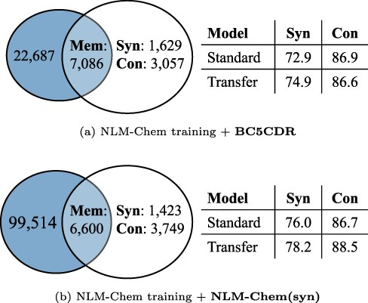
Figure 4. The number of mentions of Mem, Syn and Con and model performance on each split, when using BC5CDR and ...
Notes:
Figure 4. The number of mentions of Mem, Syn and Con and model performance on each split, when using BC5CDR and NLM-Chem(syn) as source data in transfer learning. The blue circles indicate the mentions in the validation set, and the others are the mentions in training sets ( i.e. $\mathbb{E}_\text{train}$). Standard and Transfer: Bio-LM-large without/with applying transfer learning, respectively.
Unless provided in the caption above, the following copyright applies to the content of this slide: © The Author(s) 2022. Published by Oxford University Press.This is an Open Access article distributed under the terms of the Creative Commons Attribution-NonCommercial License (https://creativecommons.org/licenses/by-nc/4.0/), which permits non-commercial re-use, distribution, and reproduction in any medium, provided the original work is properly cited. For commercial re-use, please contact journals.permissions@oup.com

