Slide 1
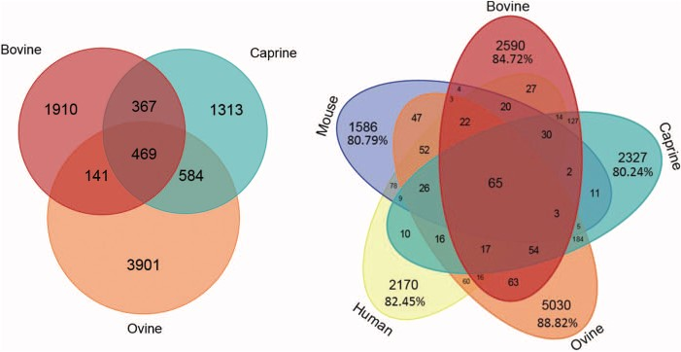
Figure 6 Number of microRNAs common to different species. Venn diagram showing bovine, caprine and ovine unique ...
Notes:
Figure 6 Number of microRNAs common to different species. Venn diagram showing bovine, caprine and ovine unique microRNAs listed in the RumimiR database. Venn diagram showing bovine, caprine and ovine microRNAs listed in the RumimiR database together with the human and mouse microRNAs listed in miRBase (release 22).
Unless provided in the caption above, the following copyright applies to the content of this slide: © The Author(s) 2019. Published by Oxford University Press.This is an Open Access article distributed under the terms of the Creative Commons Attribution License (http://creativecommons.org/licenses/by/4.0/), which permits unrestricted reuse, distribution, and reproduction in any medium, provided the original work is properly cited.

