Slide 1
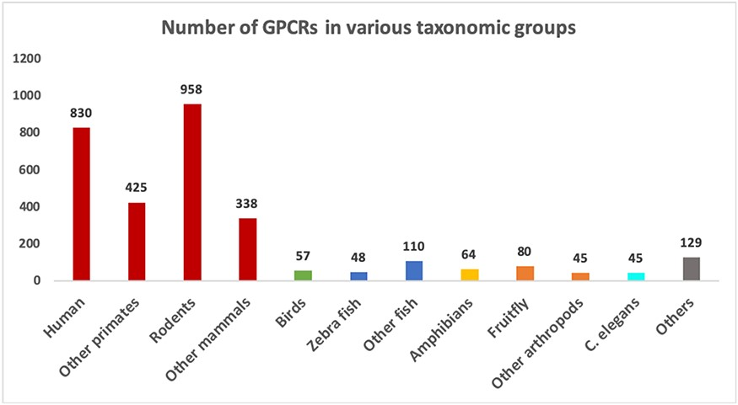
Figure 3. Number of sequences in different groups of organisms in the GPCR datasets. Groups with more than 40 sequences ...
Notes:
Figure 3. Number of sequences in different groups of organisms in the GPCR datasets. Groups with more than 40 sequences are shown as separate bars. The remaining ones are grouped as “Others”.
Unless provided in the caption above, the following copyright applies to the content of this slide: © The Author(s) 2020. Published by Oxford University Press.This is an Open Access article distributed under the terms of the Creative Commons Attribution License (http://creativecommons.org/licenses/by/4.0/), which permits unrestricted reuse, distribution, and reproduction in any medium, provided the original work is properly cited.

