Slide 1
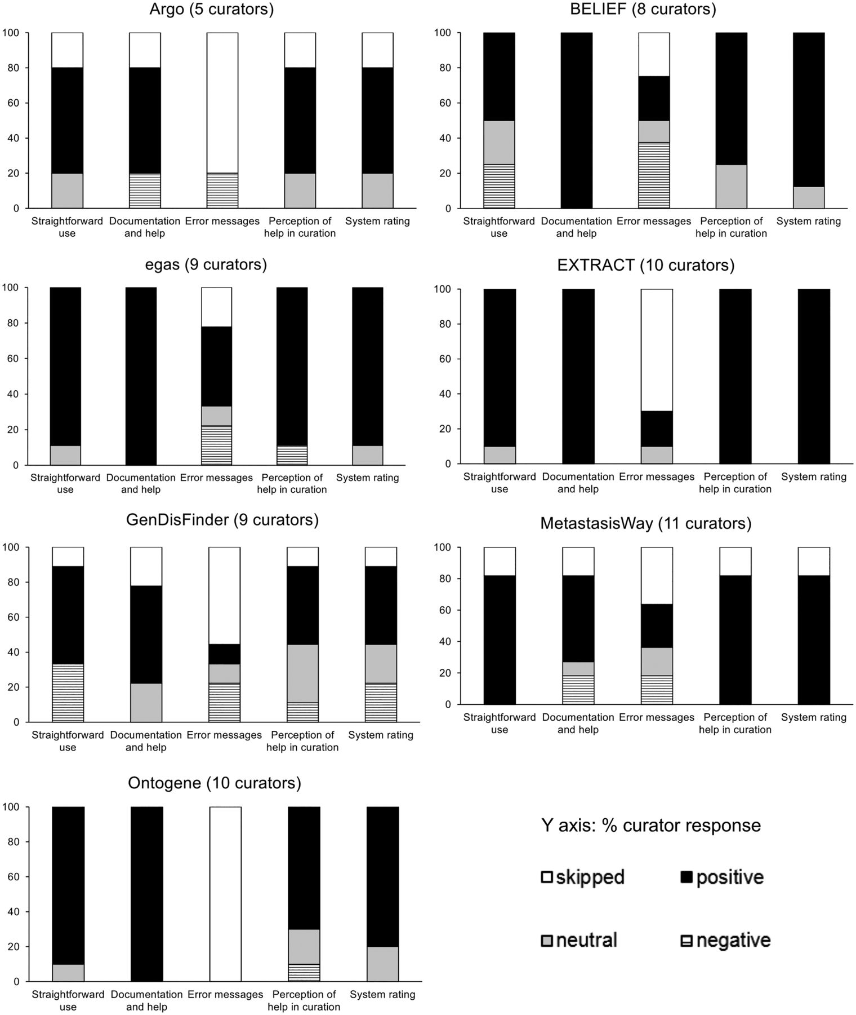
Figure 2. Pooled responses to questions related to system perception of usability from the pre-designed task activity.
Notes:
Figure 2. Pooled responses to questions related to system perception of usability from the pre-designed task activity.
Unless provided in the caption above, the following copyright applies to the content of this slide: Published by Oxford University Press 2016. This work is written by US Government employees and is in the public domain in the US.

