Slide 1
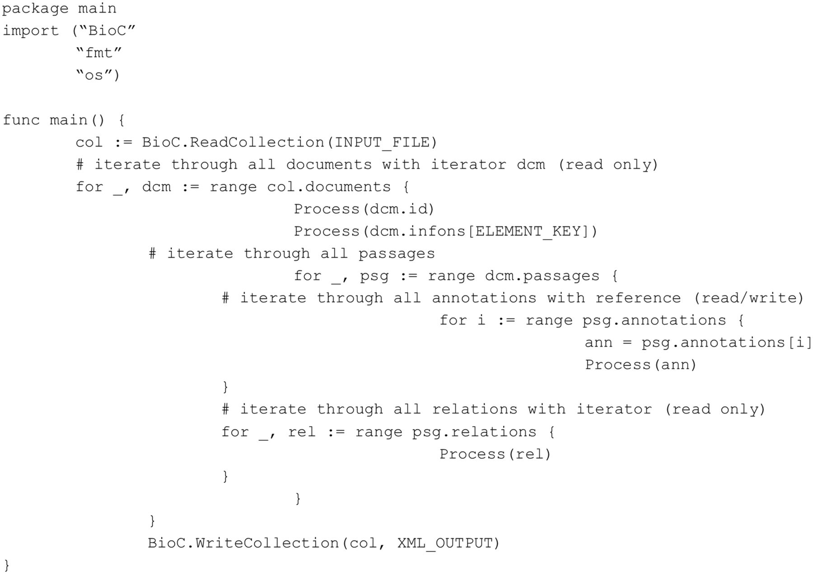
Figure 7. Go code accessing BioC data (tested with Go 1.1.2).
Notes:
Figure 7. Go code accessing BioC data (tested with Go 1.1.2).
Unless provided in the caption above, the following copyright applies to the content of this slide: Published by Oxford University Press 2014. This work is written by US Government employees and is in the public domain in the US.

