Slide 1
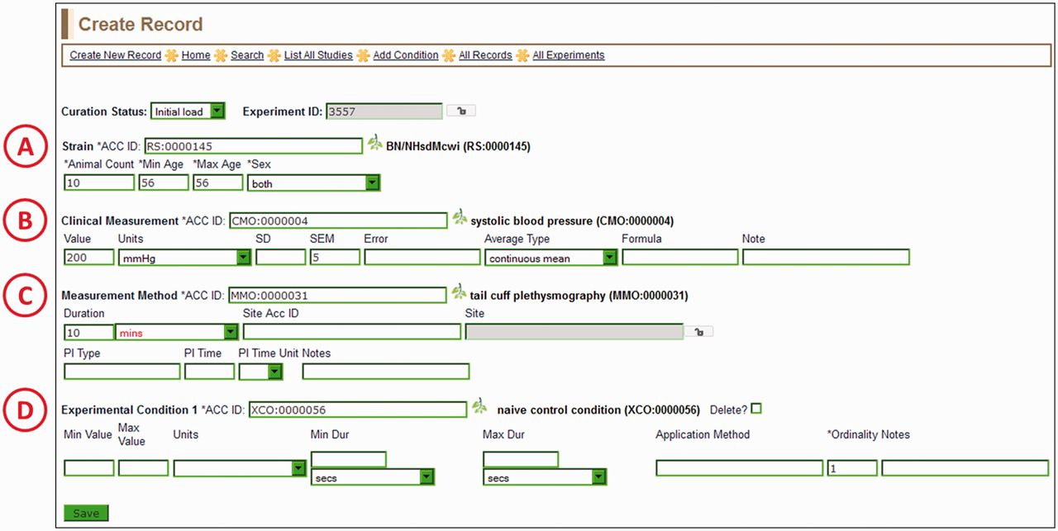
Figure 4 Create Record Page—most of the information for a manual PhenoMiner annotation is entered here. Four ...
Notes:
Figure 4 Create Record Page—most of the information for a manual PhenoMiner annotation is entered here. Four ontology/vocabulary terms are required and many more optional fields allow the addition of basic experimental information. In this example, the rat strain (A) is BN/NHsdMcwi, the CMO term (B) is ‘systolic blood pressure’, the MMO term (C) is ‘tail cuff plethysmography’ and the XCO term (D) is ‘naïve control condition’. The optional MA term goes in the ‘Site ACC ID’ text box in the measurement method section (C).
Unless provided in the caption above, the following copyright applies to the content of this slide: © The Author(s) 2013. Published by Oxford University Press.This is an Open Access article distributed under the terms of the Creative Commons Attribution Non-Commercial License (http://creativecommons.org/licenses/by-nc/3.0/), which permits unrestricted non-commercial use, distribution, and reproduction in any medium, provided the original work is properly cited.

