Slide 1
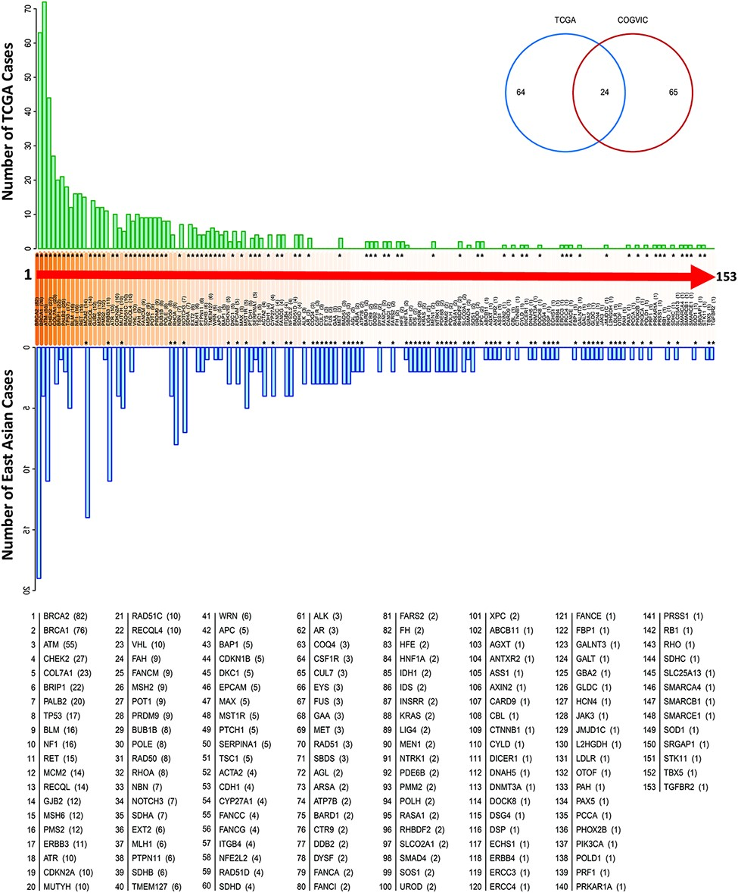
Figure 2. Genes with pathogenic variants identified in the COGVIC and TCGA cohorts. Distribution of the variants among ...
Notes:
Figure 2. Genes with pathogenic variants identified in the COGVIC and TCGA cohorts. Distribution of the variants among 153 genes in both cohorts. The number of cases with pathogenic variants by gene in the TCGA database (green upper bars) is compared with those in the East Asian population (blue lower bars). Differences between the databases are indicated by asterisks above the gene name (when the number of TCGA cases is greater) or below the gene name (when the number of cases for the gene in the East Asian population is greater). The numbers in brackets beside the gene name are consistent with this system, i.e. asterisks above the number in the bracket indicate the number of TCGA cases, while asterisks below it indicate the number of cases in the East Asian population. The Venn diagram shows 64 genes with mutations unique to TCGA, 65 genes with mutations unique to the East Asian population and 24 genes with mutations detected in the two populations.
Unless provided in the caption above, the following copyright applies to the content of this slide: © The Author(s) 2021. Published by Oxford University Press.This is an Open Access article distributed under the terms of the Creative Commons Attribution License (https://creativecommons.org/licenses/by/4.0/), which permits unrestricted reuse, distribution, and reproduction in any medium, provided the original work is properly cited.

