Slide 1
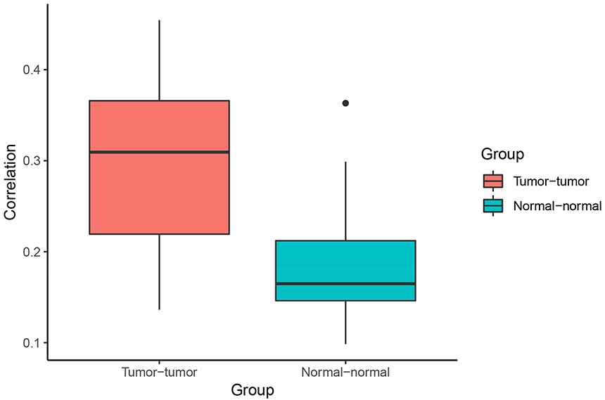
Figure 4. Correlation of Pagerank scores between tumor networks (red) and normal networks (blue). On average, the ...
Notes:
Figure 4. Correlation of Pagerank scores between tumor networks (red) and normal networks (blue). On average, the correlation between Pagerank scores in tumor networks was higher than the correlation between Pagerank scores in normal networks (excluding the two normal lung tissue networks). Higher PageRank scores indicate higher centrality in the network.
Unless provided in the caption above, the following copyright applies to the content of this slide: © The Author(s) 2020. Published by Oxford University Press.This is an Open Access article distributed under the terms of the Creative Commons Attribution License (http://creativecommons.org/licenses/by/4.0/), which permits unrestricted reuse, distribution, and reproduction in any medium, provided the original work is properly cited.

