Slide 1
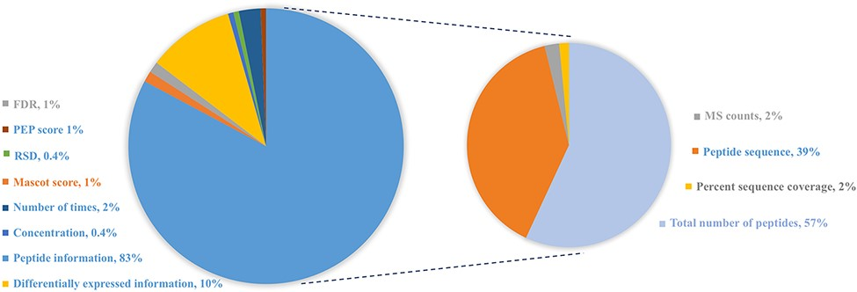
Figure 3. Distribution of protein abundance methods in HBFP database based on a number of original quantitative ...
Notes:
Figure 3. Distribution of protein abundance methods in HBFP database based on a number of original quantitative analysis methods from the original literature studies. Note that the sum of protein abundance is not 100% since not all of the literature studies provide quantitative analysis information.
Unless provided in the caption above, the following copyright applies to the content of this slide: © The Author(s) 2021. Published by Oxford University Press.This is an Open Access article distributed under the terms of the Creative Commons Attribution License (https://creativecommons.org/licenses/by/4.0/), which permits unrestricted reuse, distribution, and reproduction in any medium, provided the original work is properly cited.

Slide 2
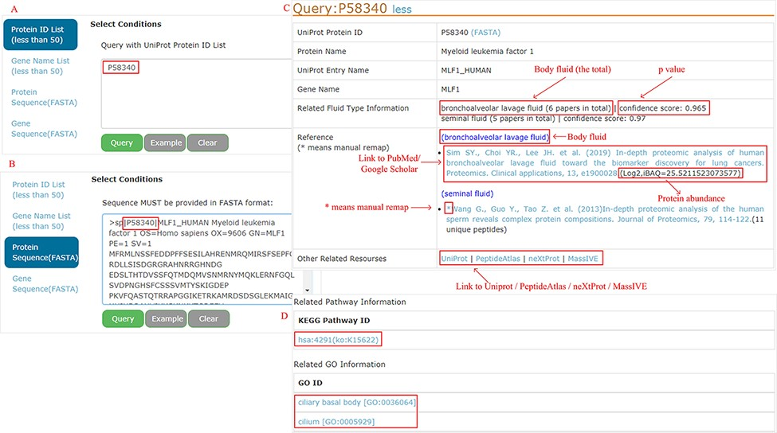
Figure 4. Example of query response with input as ‘P58340’ in the protein ID and protein sequence box.
Notes:
Figure 4. Example of query response with input as ‘P58340’ in the protein ID and protein sequence box.
Unless provided in the caption above, the following copyright applies to the content of this slide: © The Author(s) 2021. Published by Oxford University Press.This is an Open Access article distributed under the terms of the Creative Commons Attribution License (https://creativecommons.org/licenses/by/4.0/), which permits unrestricted reuse, distribution, and reproduction in any medium, provided the original work is properly cited.

Slide 3
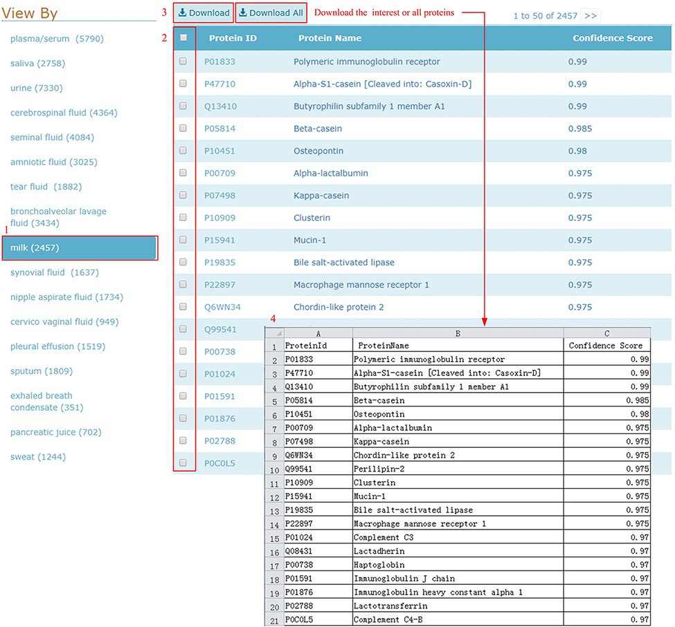
Figure 5. Download illustration where user can choose the body fluid name and download the proteins of interest or all ...
Notes:
Figure 5. Download illustration where user can choose the body fluid name and download the proteins of interest or all proteins.
Unless provided in the caption above, the following copyright applies to the content of this slide: © The Author(s) 2021. Published by Oxford University Press.This is an Open Access article distributed under the terms of the Creative Commons Attribution License (https://creativecommons.org/licenses/by/4.0/), which permits unrestricted reuse, distribution, and reproduction in any medium, provided the original work is properly cited.

Slide 4
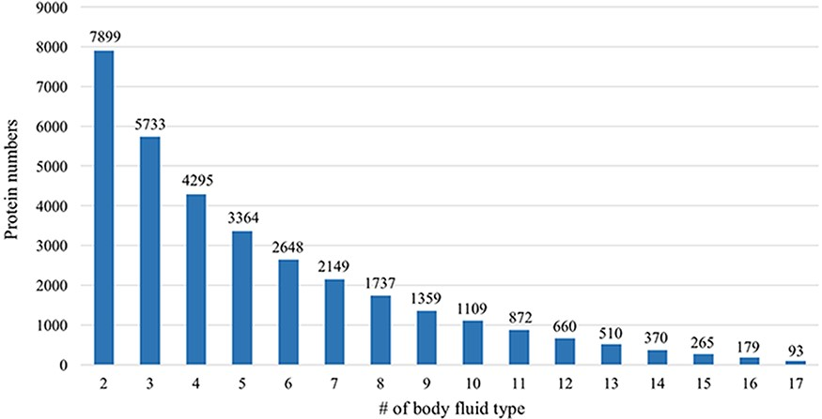
Figure 6. Comparative analysis across different body fluids. Seven thousand eight hundred and ninety-nine (7899) ...
Notes:
Figure 6. Comparative analysis across different body fluids. Seven thousand eight hundred and ninety-nine (7899) proteins are presented in at least two body fluids and 5733 proteins existed in at least three body fluids. Only 93 proteins exist in all 17 body fluids.
Unless provided in the caption above, the following copyright applies to the content of this slide: © The Author(s) 2021. Published by Oxford University Press.This is an Open Access article distributed under the terms of the Creative Commons Attribution License (https://creativecommons.org/licenses/by/4.0/), which permits unrestricted reuse, distribution, and reproduction in any medium, provided the original work is properly cited.

Slide 5
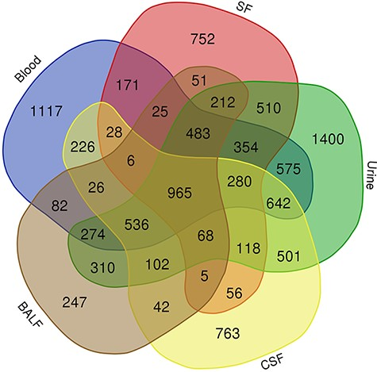
Figure 7. Venn diagram showing the common proteins among five body fluids (blood, urine, CSF, SF and BALF) that have ...
Notes:
Figure 7. Venn diagram showing the common proteins among five body fluids (blood, urine, CSF, SF and BALF) that have the most number of proteins in the HBFP.
Unless provided in the caption above, the following copyright applies to the content of this slide: © The Author(s) 2021. Published by Oxford University Press.This is an Open Access article distributed under the terms of the Creative Commons Attribution License (https://creativecommons.org/licenses/by/4.0/), which permits unrestricted reuse, distribution, and reproduction in any medium, provided the original work is properly cited.

Slide 6
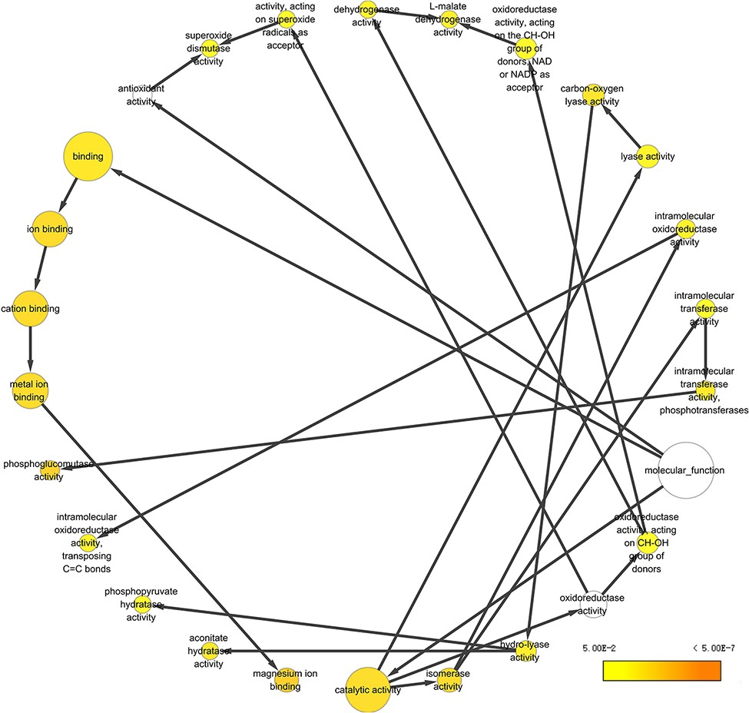
Figure 8. Example of GO annotation based on the 965 proteins common in five body fluids.
Notes:
Figure 8. Example of GO annotation based on the 965 proteins common in five body fluids.
Unless provided in the caption above, the following copyright applies to the content of this slide: © The Author(s) 2021. Published by Oxford University Press.This is an Open Access article distributed under the terms of the Creative Commons Attribution License (https://creativecommons.org/licenses/by/4.0/), which permits unrestricted reuse, distribution, and reproduction in any medium, provided the original work is properly cited.

