Slide 1
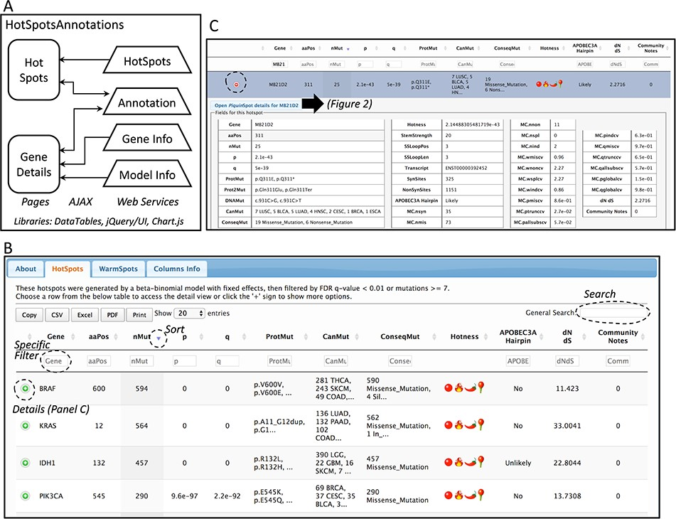
Figure 1 Database web implementation. (A) Implementation. There are two web pages, ‘Hot-Spots’ which list all ...
Notes:
Figure 1 Database web implementation. (A) Implementation. There are two web pages, ‘Hot-Spots’ which list all hotspots, and ‘Gene Details’ which shows the details for the gene including all mutations and hotspots. There are four web services that provides the data for the pages (HotSpots, Annotation, Gene Info and Model Info). Examples of the web pages are shown in B and C and in Figure 2. (B) The first web page listing all hotspots. The list can be filtered, searched, exported and selected to open details. (C) Example of the estimation details for a hotspot.
Unless provided in the caption above, the following copyright applies to the content of this slide: © The Author(s) 2020. Published by Oxford University Press.This is an Open Access article distributed under the terms of the Creative Commons Attribution License (http://creativecommons.org/licenses/by/4.0/), which permits unrestricted reuse, distribution, and reproduction in any medium, provided the original work is properly cited.

