Slide 1
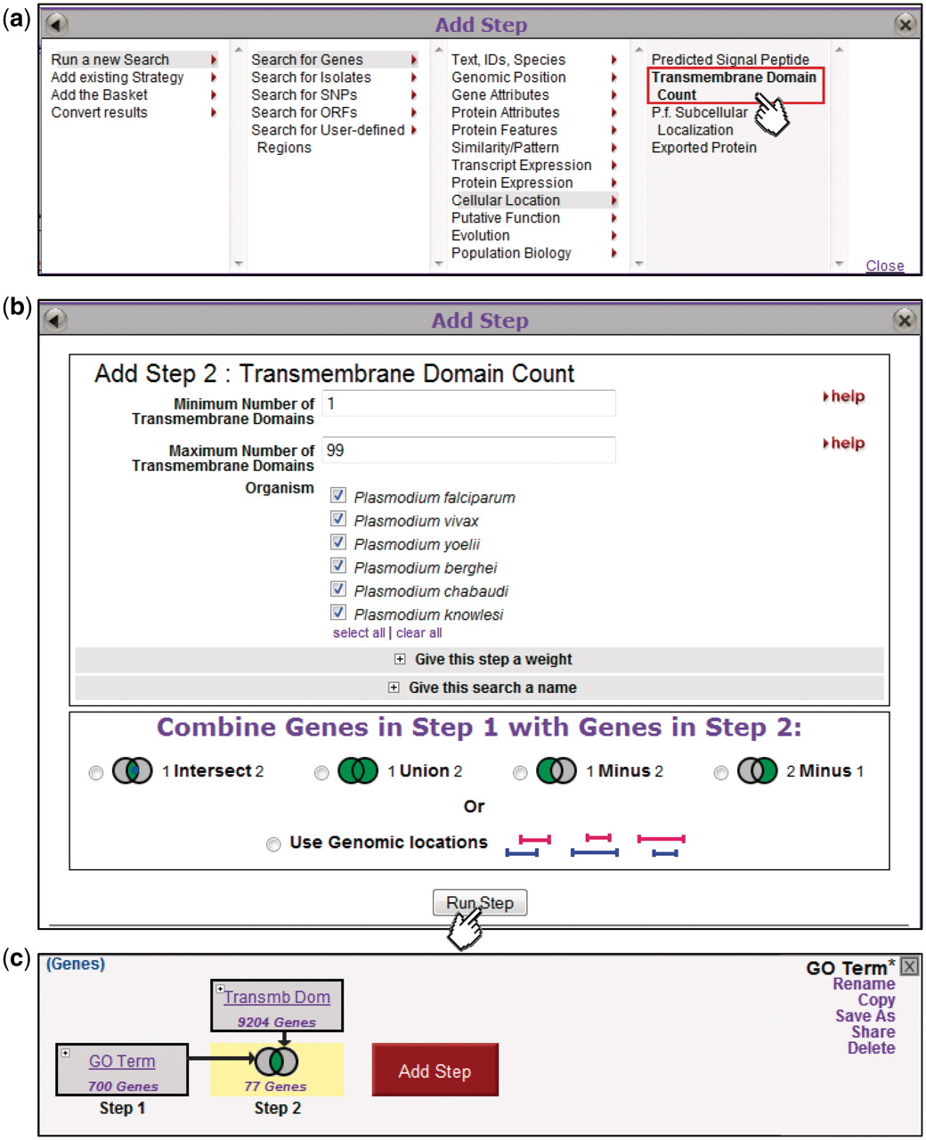
Figure 3. Adding steps to build a more complex strategy. Clicking on the Add Step button (Fig. 2) brings up an Add Step ...
Notes:
Figure 3. Adding steps to build a more complex strategy. Clicking on the Add Step button (Fig. 2) brings up an Add Step dialog box (a), from which the user selects which search to run. This brings up a display showing parameters for that search (b, top) and options for combining with the previous step (b, bottom). The new step is added to the strategy (c), and the combined result highlighted and returned as a list in the Summary Display (data not shown).
Unless provided in the caption above, the following copyright applies to the content of this slide: © The Author(s) 2011. Published by Oxford University Press.This is Open Access article distributed under the terms of the Creative Commons Attribution Non-Commercial License (http://creativecommons.org/licenses/by-nc/2.5), which permits unrestricted non-commercial use, distribution, and reproduction in any medium, provided the original work is properly cited.

