Slide 1
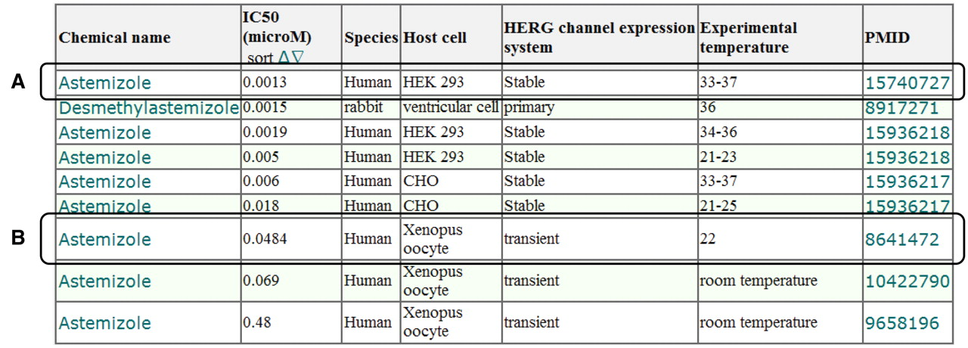
Figure 5. Screen capture of the hERG assay results for astemizole. (A) Example of hERG assay result using hERG channel ...
Notes:
Figure 5. Screen capture of the hERG assay results for astemizole. (A) Example of hERG assay result using hERG channel stably expressed on HEK 293 cells. (B) Example of hERG assay result using a hERG channel transiently expressed in a Xenopus oocyte. The attributes listed in the results table, i.e. chemical name, IC50 (µM), species, host cell and PMID, indicate the name of the chemical compounds, the half maximal inhibitory concentration of the hERG channel, the origin of the hERG channel, cell with natural and/or artificial expression of hERG channel and PMID, respectively.
Unless provided in the caption above, the following copyright applies to the content of this slide: © The Author(s) 2011. Published by Oxford University Press.This is Open Access article distributed under the terms of the Creative Commons Attribution Non-Commercial License (http://creativecommons.org/licenses/by-nc/2.5), which permits unrestricted non-commercial use, distribution, and reproduction in any medium, provided the original work is properly cited.

