Slide 1
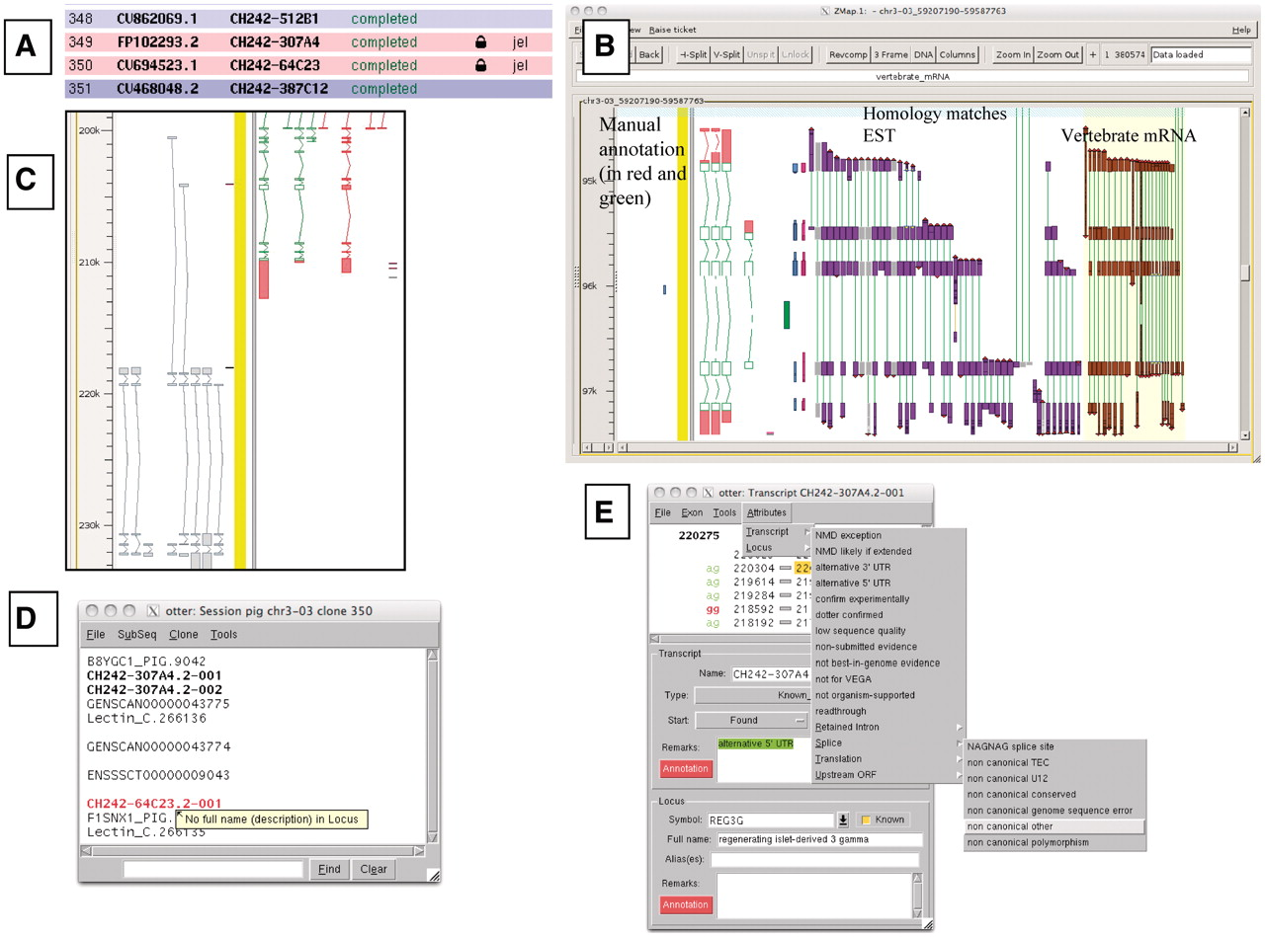
Figure 1. A selection of different views of Otterlace and ZMap. (A) Assembly sequence chooser showing user’s email ...
Notes:
Figure 1. A selection of different views of Otterlace and ZMap. (A) Assembly sequence chooser showing user’s email displayed on locked clones. (B) ZMap view of the results of pipeline analysis, namely EST (in purple) and vertebrate mRNA (in brown) homology matches together with manually annotated transcripts (in red and green). (C) Manual annotation shown as ‘greyed out’, non-editable transcripts where they extend past the genomic region that has been opened. (D) Internal QC displaying a ‘tool tip’. (E) Transcript editing window showing a non-consensus splice site that has been highlighted in red, and a selection of attributes available at the transcript level (green shaded text).
Unless provided in the caption above, the following copyright applies to the content of this slide: © The Author(s) 2012. Published by Oxford University Press.This is an Open Access article distributed under the terms of the Creative Commons Attribution Non-Commercial License (http://creativecommons.org/licenses/by-nc/3.0), which permits unrestricted non-commercial use, distribution, and reproduction in any medium, provided the original work is properly cited.

Slide 2
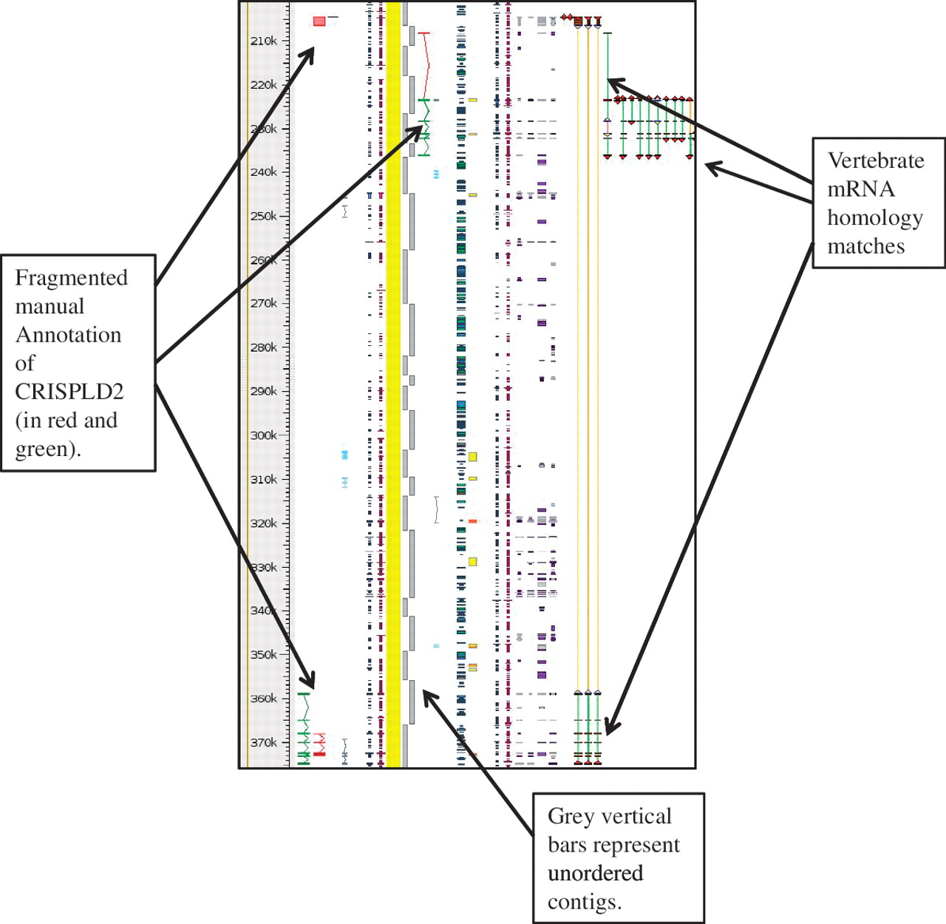
Figure 4. Unordered contigs on pig chromosome 6 viewed in Zmap. The annotation of the CRISPLD2 gene shows clearly how ...
Notes:
Figure 4. Unordered contigs on pig chromosome 6 viewed in Zmap. The annotation of the CRISPLD2 gene shows clearly how the annotation highlights the fragmented nature of the assembly and aids in identifying the correct contig ordering. The vertebrate mRNA homology matches show the mismatches in the contiguity of the sequence. If sequence is contiguous the connecting lines between the matches are green, but where there is missing or incorrectly ordered sequence the connecting lines are orange.
Unless provided in the caption above, the following copyright applies to the content of this slide: © The Author(s) 2012. Published by Oxford University Press.This is an Open Access article distributed under the terms of the Creative Commons Attribution Non-Commercial License (http://creativecommons.org/licenses/by-nc/3.0), which permits unrestricted non-commercial use, distribution, and reproduction in any medium, provided the original work is properly cited.

Slide 3
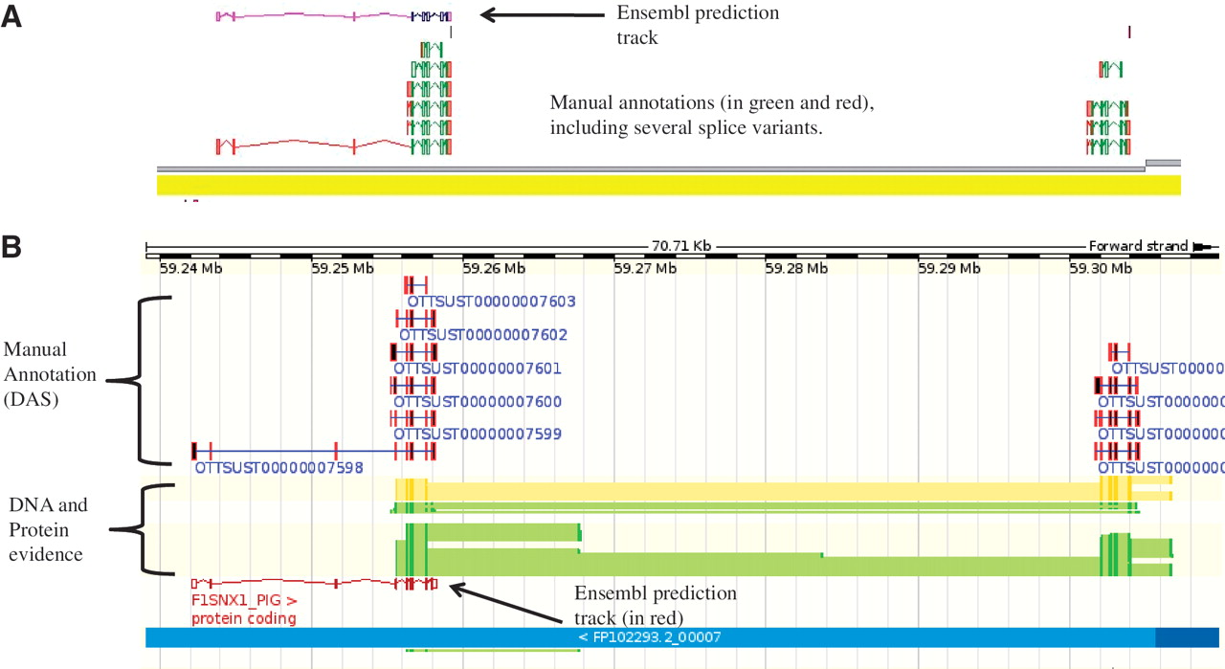
Figure 3. An example of manually annotated genes viewed in ZMap and also displayed as a DAS track in Ensembl. (A) ZMap ...
Notes:
Figure 3. An example of manually annotated genes viewed in ZMap and also displayed as a DAS track in Ensembl. (A) ZMap view of copies of the REG3G gene in pig. The automated Ensembl track predicts one copy of the gene, whilst the manual annotation can resolve two copies in this section of the genome. (B) Ensembl view of the same region displaying the manual annotation DAS track.
Unless provided in the caption above, the following copyright applies to the content of this slide: © The Author(s) 2012. Published by Oxford University Press.This is an Open Access article distributed under the terms of the Creative Commons Attribution Non-Commercial License (http://creativecommons.org/licenses/by-nc/3.0), which permits unrestricted non-commercial use, distribution, and reproduction in any medium, provided the original work is properly cited.

Slide 4
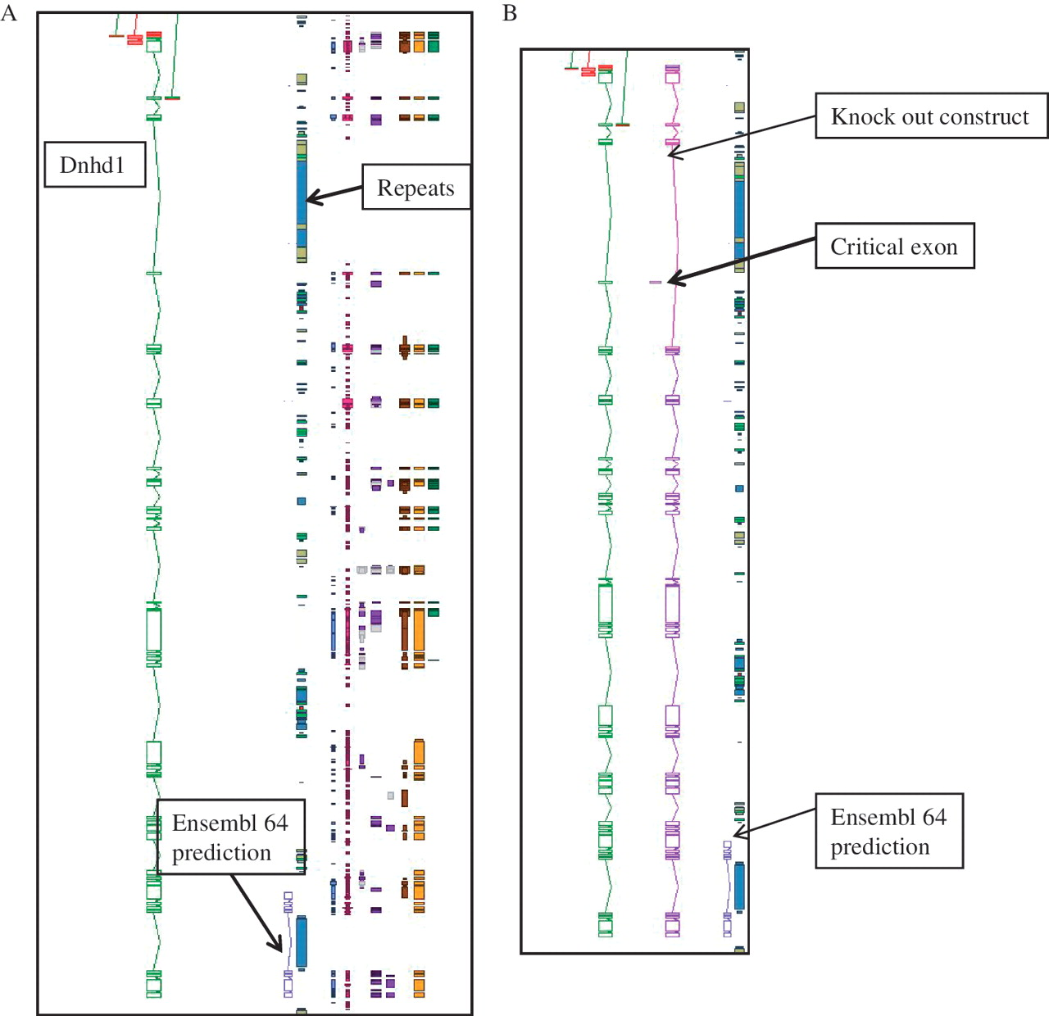
Figure 2. An example of manual annotation in mouse to identify a critical exon. (A) Dnhd1 is a KOMP target gene that is ...
Notes:
Figure 2. An example of manual annotation in mouse to identify a critical exon. (A) Dnhd1 is a KOMP target gene that is automatically chosen to create a knockout from the Ensembl prediction. A Zmap view of the Dnhd1 gene manually annotated in mouse. The Ensembl 64 prediction is partial, probably due to the highly repetitive nature of the genomic region. (B) A Zmap view of the position of the critical exon identified after completion fo the manual annotation and the associate knockout construct. If the Ensembl prediction had been used as a model to create the knockout a rage proportion of the gene would have been missed. This would have resulted in an unsuccessful knockout construct.
Unless provided in the caption above, the following copyright applies to the content of this slide: © The Author(s) 2012. Published by Oxford University Press.This is an Open Access article distributed under the terms of the Creative Commons Attribution Non-Commercial License (http://creativecommons.org/licenses/by-nc/3.0), which permits unrestricted non-commercial use, distribution, and reproduction in any medium, provided the original work is properly cited.

