Slide 1
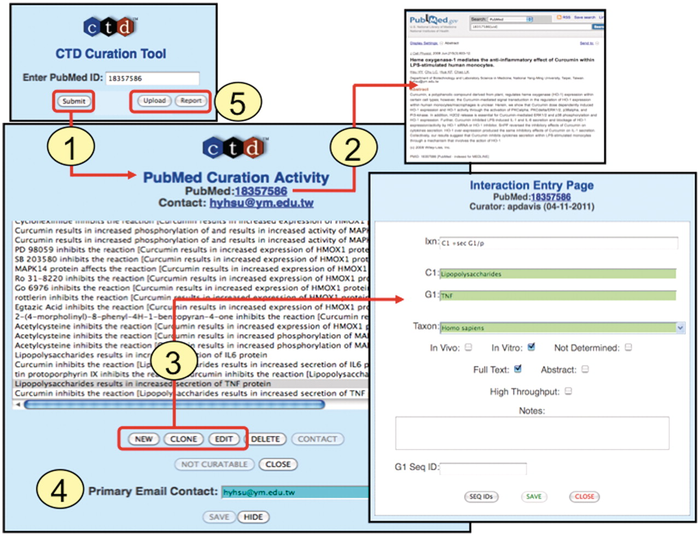
Figure 4. Curation tool overview. (1) Biocurators submit a PMID to create a ‘PubMed Curation Activity’ page. (2) This ...
Notes:
Figure 4. Curation tool overview. (1) Biocurators submit a PMID to create a ‘PubMed Curation Activity’ page. (2) This page has a hyperlink to the PubMed abstract, which the biocurators use for curation. (3) Based upon the abstract, biocurators can then enter new interactions, edit pre-existing interactions, or clone interactions (to modify any data field to generate a new interaction without having to re-enter all the fields each time). On the ‘Interaction Entry Page’ biocurators construct the interaction using structured notation and mnemonic codes and fill in the necessary data fields. Additional internal data not yet currently displayed on the public website can also be selected, including: in vivo versus in vitro methods, full-text versus abstract curation (to help with subsequent text-mining evaluations), if the curation was derived from a high-throughput assay, any type of gene accession ID and curator notes (for any other helpful comment about the curation). (4) When available, the email address of the corresponding author is stored. (5) Additional features allow the biocurator to upload data en masse from an Excel spreadsheet or generate a report of their previously submitted work.
Unless provided in the caption above, the following copyright applies to the content of this slide: © The Author(s) 2011. Published by Oxford University Press.This is Open Access article distributed under the terms of the Creative Commons Attribution Non-Commercial License (http://creativecommons.org/licenses/by-nc/2.5), which permits unrestricted non-commercial use, distribution, and reproduction in any medium, provided the original work is properly cited.

