Slide 1
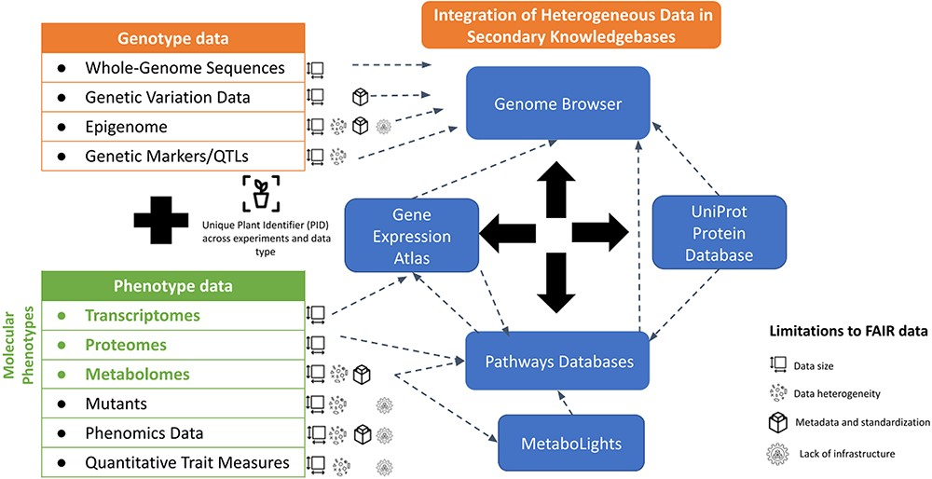
Figure 1. Current status of genotype-to-phenotype data integration. The left side illustrates the diversity of genotype ...
Notes:
Figure 1. Current status of genotype-to-phenotype data integration. The left side illustrates the diversity of genotype and phenotype data. The right-hand side lists examples of the existing databases and knowledgebases which support the integration of heterogenous data types and their visualization.
Unless provided in the caption above, the following copyright applies to the content of this slide: © The Author(s) 2023. Published by Oxford University Press.This is an Open Access article distributed under the terms of the Creative Commons Attribution License (https://creativecommons.org/licenses/by/4.0/), which permits unrestricted reuse, distribution, and reproduction in any medium, provided the original work is properly cited.

