Slide 1
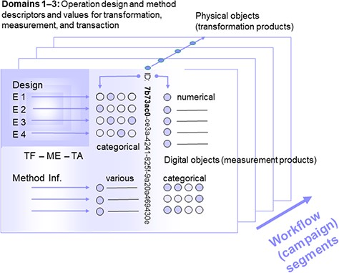
Figure 1 Segment of a (multi-segment) workflow or a (multi-segment) campaign with object identity (ID), operation ...
Notes:
Figure 1 Segment of a (multi-segment) workflow or a (multi-segment) campaign with object identity (ID), operation design elements and method information, as well as measurement values as assigned to physical (and digital) objects. Consecutive segments (indicated by the arrow at the lower right) are linked via parent identifier relations of the preceding physical objects or their digital representatives (parent identity relation). Operations are grouped according to the domains transformation, measurement and transaction (TF: transformation design, referring to domain 1, ME: method design, referring to domain 2, TA: transaction design, referring to domain 3), being assigned to (physical and digital) objects by declaration or selection of descriptor states (categorical, various). Measurement (or observation) values are primarily generated from physical objects (and secondarily from digital objects).
Unless provided in the caption above, the following copyright applies to the content of this slide: © The Author(s) 2020. Published by Oxford University Press.This is an Open Access article distributed under the terms of the Creative Commons Attribution License (http://creativecommons.org/licenses/by/4.0/), which permits unrestricted reuse, distribution, and reproduction in any medium, provided the original work is properly cited.

