Slide 1
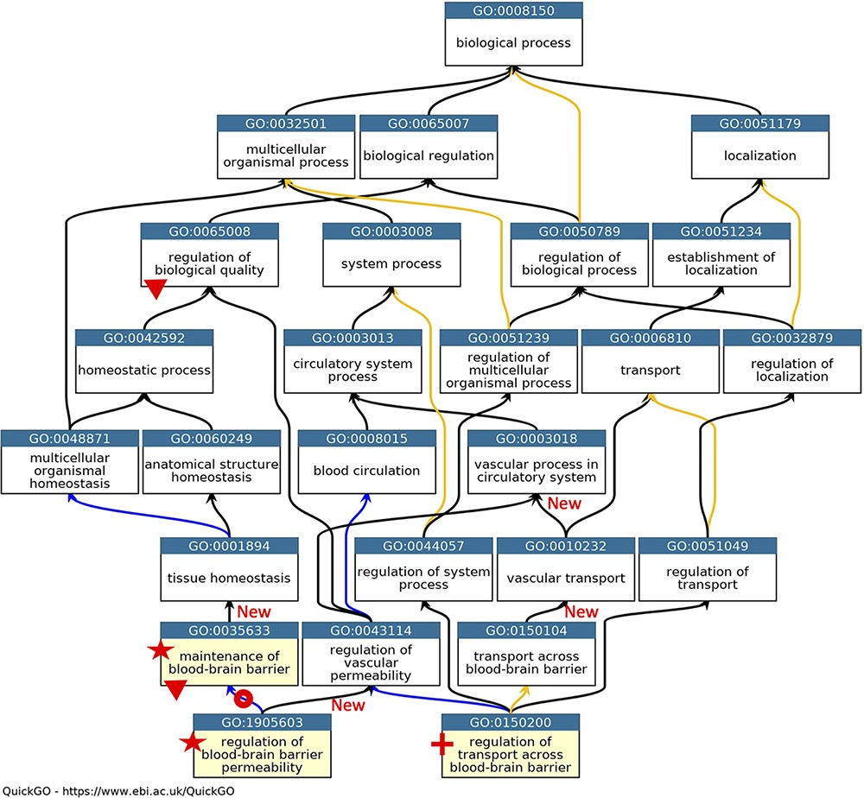
Figure 1. GO describing permeability of the BBB. A subset of the GO terms describing the processes occurring at the ...
Notes:
Figure 1. GO describing permeability of the BBB. A subset of the GO terms describing the processes occurring at the BBB. GO terms are listed in separate nodes and the descendant relationships are indicated by black, blue and yellow arrows, for ‘is_a’, ‘part_of’ and ‘regulates’ relations, respectively. The GO term identifiers and names are included in each node. The yellow highlighted nodes indicate either a new GO term or a revised term name. The new GO term, GO:0150200 ‘regulation of transport across blood-brain barrier’, is indicated by a red cross; the new relations associated with this new term are not individually highlighted. A red star indicates the two terms with changed GO term names: GO:0035633 renamed as ‘maintenance of blood-brain barrier’ rather than ‘maintenance of permeability of blood-brain barrier’ and GO:1905603 renamed as ‘regulation of blood-brain barrier permeability’ rather than ‘regulation of maintenance of permeability of blood-brain barrier’. The red doughnut indicates a change in the relation ‘regulates’ to ‘part_of’ between GO:0035633 ‘maintenance of blood-brain barrier’ and GO:1905603 ‘regulation of blood-brain barrier permeability’. A red triangle indicates GO terms which have had descendant relations removed, GO:0035633 ‘maintenance of blood-brain barrier’ was removed as a child term from GO:0065008 ‘regulation of biological quality’; two terms describing positive and negative regulation of BBB permeability (GO:1905605 and GO:1905604) were removed as direct descendants of GO:0035633 ‘maintenance of blood-brain barrier’. New ‘is_a’ relations are indicated by ‘New’. Screenshot of the GO taken from QuickGO (11).
Unless provided in the caption above, the following copyright applies to the content of this slide: © The Author(s) 2021. Published by Oxford University Press.This is an Open Access article distributed under the terms of the Creative Commons Attribution License (https://creativecommons.org/licenses/by/4.0/), which permits unrestricted reuse, distribution, and reproduction in any medium, provided the original work is properly cited.

Slide 2
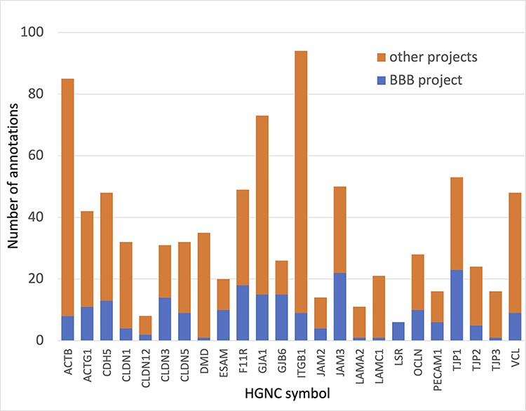
Figure 4. Annotation of proteins involved maintenance of cell junctions at the BBB. The number of BBB-relevant ...
Notes:
Figure 4. Annotation of proteins involved maintenance of cell junctions at the BBB. The number of BBB-relevant annotations created for each of the cell junction priority proteins as part of the BBB-focused annotation project (BBB project), compared to the total number of annotations associated with these proteins. A BBB slim (Supplementary Table S5) was used to download potentially BBB-relevant annotations from QuickGO (11) (28 May 2021). All annotations are associated with these proteins and can be viewed online using the following link: https://tinyurl.com/y59y8e7c.
Unless provided in the caption above, the following copyright applies to the content of this slide: © The Author(s) 2021. Published by Oxford University Press.This is an Open Access article distributed under the terms of the Creative Commons Attribution License (https://creativecommons.org/licenses/by/4.0/), which permits unrestricted reuse, distribution, and reproduction in any medium, provided the original work is properly cited.

Slide 3
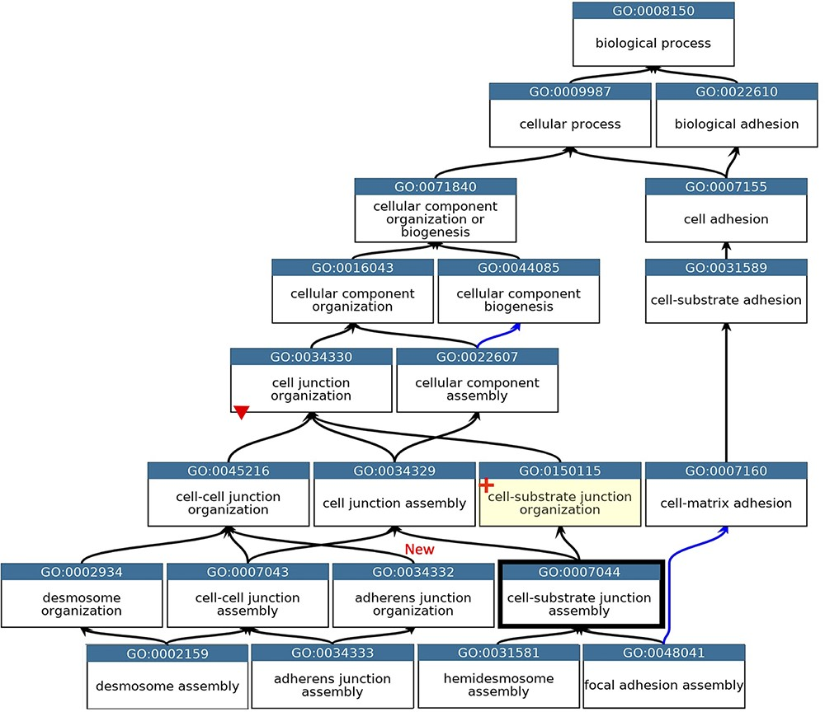
Figure 2. GO describing the biological process cell junction assembly. A subset of the GO terms describing the assembly ...
Notes:
Figure 2. GO describing the biological process cell junction assembly. A subset of the GO terms describing the assembly of a selection of cell junctions modified to align with the revised cellular component ontology. GO terms are listed in separate nodes and the descendant relationships are indicated by black and blue arrows, for ‘is_a’ and ‘part_of’ relations, respectively. The GO term identifiers and names are included in each node. The yellow highlighted node with a red cross indicates the new GO term, GO:0150115 ‘cell-substrate junction organization’ and its associated new relations. The thick node outline indicates that the GO term ‘cell-substrate adherens junction assembly’ was merged into ‘cell-substrate junction assembly’. A red triangle indicates the removal of an ‘is_a’ parent relation between the GO:0034330 ‘cell junction organization’ and GO:0034332 ‘adherens junction organisation’ terms. An added ‘is_a’ relation between GO:0034332 ‘adherens junction organisation’ and GO:0045216 ‘cell-cell junction organization’ is indicated ‘New’. Screenshot of the GO taken from QuickGO (11).
Unless provided in the caption above, the following copyright applies to the content of this slide: © The Author(s) 2021. Published by Oxford University Press.This is an Open Access article distributed under the terms of the Creative Commons Attribution License (https://creativecommons.org/licenses/by/4.0/), which permits unrestricted reuse, distribution, and reproduction in any medium, provided the original work is properly cited.

Slide 4
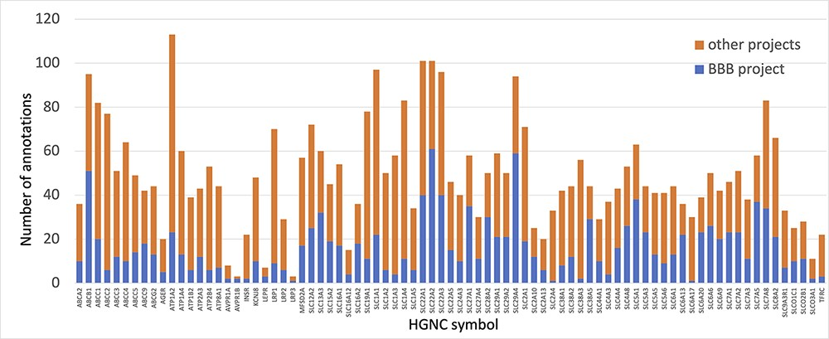
Figure 3. Annotation of proteins involved in transport at the BBB. The number of BBB-relevant annotations created for ...
Notes:
Figure 3. Annotation of proteins involved in transport at the BBB. The number of BBB-relevant annotations created for each of the transport priority proteins as part of the BBB-focused annotation project (BBB project), compared to the total number of annotations associated with these proteins. A BBB slim (Supplementary Table S5) was used to download potentially BBB-relevant annotations from QuickGO (11) (28 May 2021). All annotations are associated with these proteins and can be viewed online using the following link: https://tinyurl.com/y59y8e7c.
Unless provided in the caption above, the following copyright applies to the content of this slide: © The Author(s) 2021. Published by Oxford University Press.This is an Open Access article distributed under the terms of the Creative Commons Attribution License (https://creativecommons.org/licenses/by/4.0/), which permits unrestricted reuse, distribution, and reproduction in any medium, provided the original work is properly cited.

Slide 5
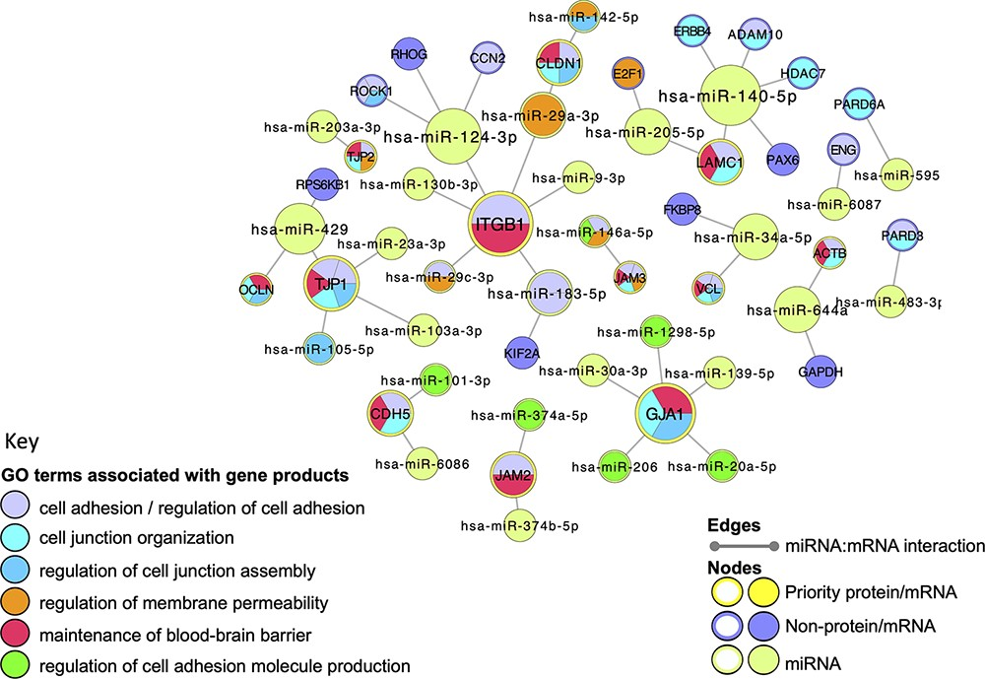
Figure 5. Cell junction focused miRNA:target network. The miRNA:target network was constructed in Cytoscape (41) by ...
Notes:
Figure 5. Cell junction focused miRNA:target network. The miRNA:target network was constructed in Cytoscape (41) by seeding with 27 human proteins, identified as miRNA:targets during the BBB-focused annotation project, and the molecular interaction data were extracted from the EBI-GOA-miRNA file (25). The size of each node represents the number of interactions included in the network; the edges represent the miRNA:target interactions. Following a GO enrichment analysis of the network, GO terms relevant to formation and maintenance of cell junctions (Table 4) were overlaid on the gene product nodes using GOlorize and BiNGO (43, 44). Molecular interaction data accessed 24 August 2020, GO association and ontology files accessed 22 March 2021.
Unless provided in the caption above, the following copyright applies to the content of this slide: © The Author(s) 2021. Published by Oxford University Press.This is an Open Access article distributed under the terms of the Creative Commons Attribution License (https://creativecommons.org/licenses/by/4.0/), which permits unrestricted reuse, distribution, and reproduction in any medium, provided the original work is properly cited.

