Slide 1
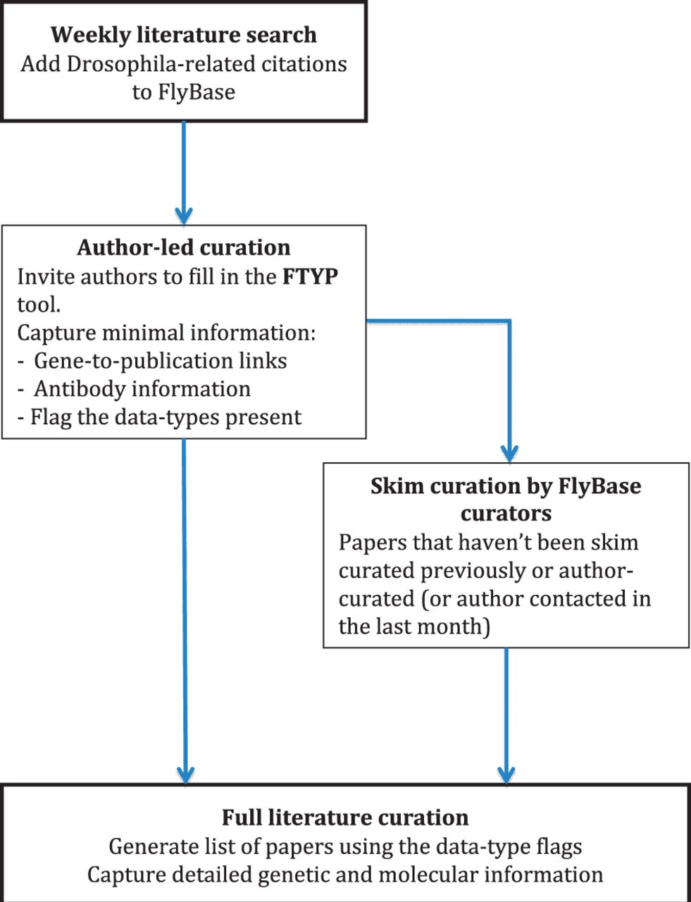
Figure 1 Literature curation pipeline. A weekly PubMed database search identifies new Drosophila-related publications. ...
Notes:
Figure 1 Literature curation pipeline. A weekly PubMed database search identifies new Drosophila-related publications. The citation details for these articles are added to our bibliography, and where possible, the associated PDF is downloaded. The correspondence email for each new article is extracted from the PDF and used to invite the author to use our FTYP tool. Through use of this tool, or a FlyBase curator ‘skim’ curating each article, gene-to-publication links are generated. These are published to our FlyBase website at the first opportunity. Data types found in the article, flagged either by the authors or curators, are then used to generate a priority list for ‘full curation’, where we extract detailed genetic and molecular information.
Unless provided in the caption above, the following copyright applies to the content of this slide: © The Author(s) 2012. Published by Oxford University Press.This is an Open Access article distributed under the terms of the Creative Commons Attribution License (http://creativecommons.org/licenses/by-nc/3.0/), which permits non-commercial reuse, distribution, and reproduction in any medium, provided the original work is properly cited. For commercial re-use, please contact journals.permissions@oup.com.

Slide 2
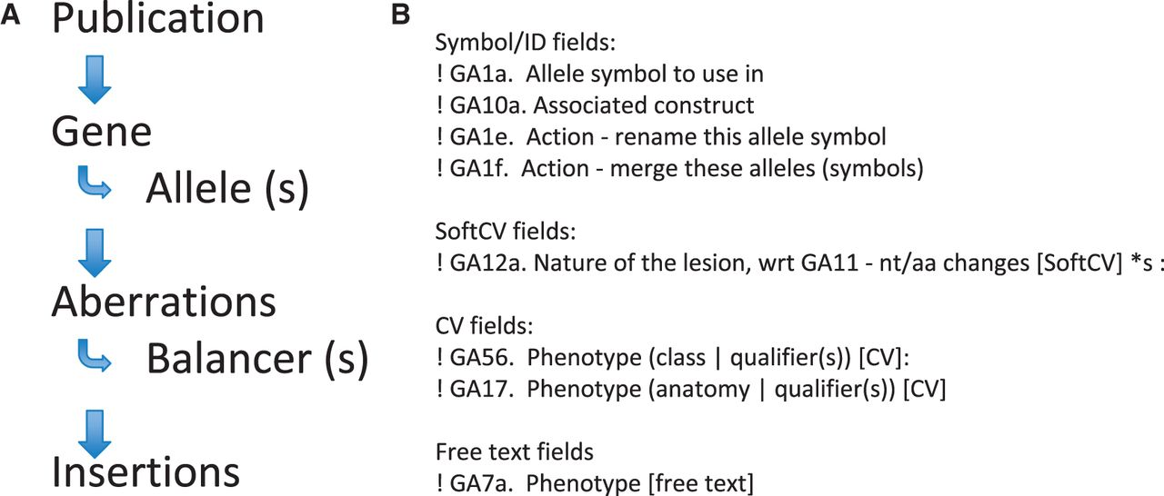
Figure 2 Literature curation into proformae. Text files composed of various proformae are used to capture data from ...
Notes:
Figure 2 Literature curation into proformae. Text files composed of various proformae are used to capture data from the literature. (A) The proformae are ordered such that each curation record has to start with a publication proforma, so all objects mentioned subsequently can be attributed to the relevant publication. Allele proformae are added underneath the parent gene proforma, so all allele information can be related back to the parent gene. (B) Proformae are split into four different types of fields. The fields start with an exclamation mark (for processing) and each field has a field code, e.g. GA1a is the allele symbol field (all fields in the allele proforma are coded GAx).
Unless provided in the caption above, the following copyright applies to the content of this slide: © The Author(s) 2012. Published by Oxford University Press.This is an Open Access article distributed under the terms of the Creative Commons Attribution License (http://creativecommons.org/licenses/by-nc/3.0/), which permits non-commercial reuse, distribution, and reproduction in any medium, provided the original work is properly cited. For commercial re-use, please contact journals.permissions@oup.com.

Slide 3
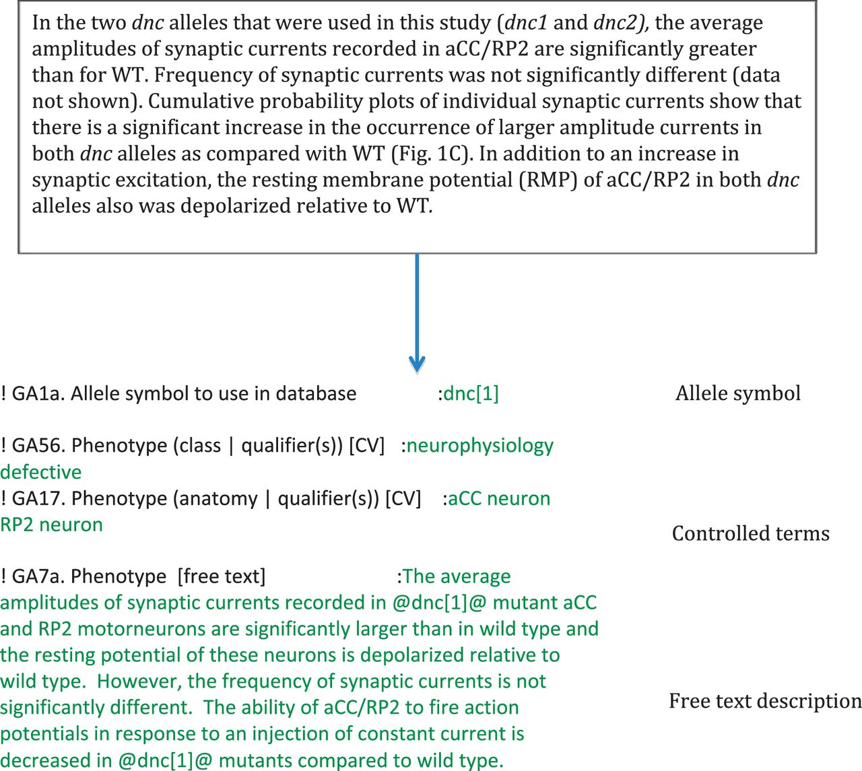
Figure 3 Phenotype curation. Example data entries for a section of text [taken from an article by Baines (2003), see ...
Notes:
Figure 3 Phenotype curation. Example data entries for a section of text [taken from an article by Baines (2003), see Ref. 5]. First, we identify the object we are ascribing the phenotype to, then we concisely curate the phenotype as free text, relating it to the object (which is placed between ‘at sign’ symbols as these symbols are hyperlinked). We then annotate the phenotype to CV terms, in this case, to terms from our ‘phenotypic class’ and ‘fly_anatomy’ ontologies.
Unless provided in the caption above, the following copyright applies to the content of this slide: © The Author(s) 2012. Published by Oxford University Press.This is an Open Access article distributed under the terms of the Creative Commons Attribution License (http://creativecommons.org/licenses/by-nc/3.0/), which permits non-commercial reuse, distribution, and reproduction in any medium, provided the original work is properly cited. For commercial re-use, please contact journals.permissions@oup.com.

