Slide 1
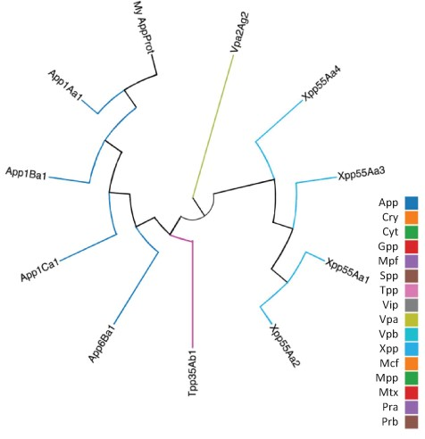
Figure 4. Guide tree showing relationships between a custom protein (My App protein) and proteins selected from the ...
Notes:
Figure 4. Guide tree showing relationships between a custom protein (My App protein) and proteins selected from the BPPRC database by the user.
Unless provided in the caption above, the following copyright applies to the content of this slide: © The Author(s) 2022. Published by Oxford University Press.This is an Open Access article distributed under the terms of the Creative Commons Attribution License (https://creativecommons.org/licenses/by/4.0/), which permits unrestricted reuse, distribution, and reproduction in any medium, provided the original work is properly cited.

