Slide 1
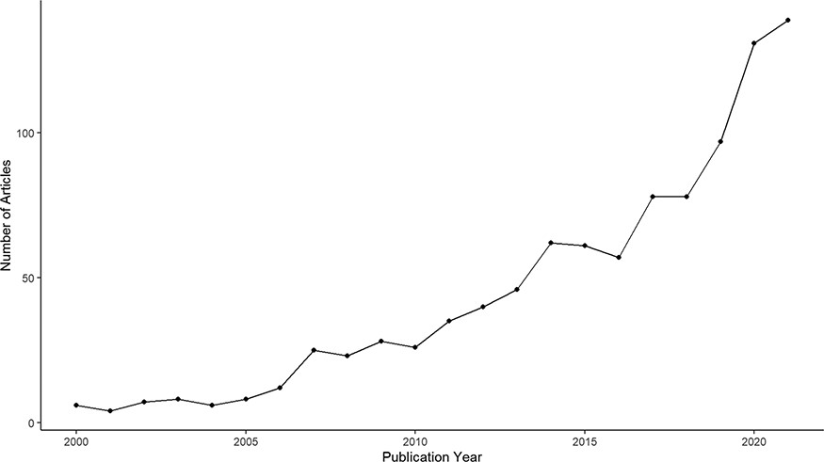
Figure 1. Annual publication of research articles containing the keyword ‘charismatic species’ between 2000 and 2021, ...
Notes:
Figure 1. Annual publication of research articles containing the keyword ‘charismatic species’ between 2000 and 2021, extracted from Clarivate Web of Science.
Unless provided in the caption above, the following copyright applies to the content of this slide: © The Author(s) 2023. Published by Oxford University Press.This is an Open Access article distributed under the terms of the Creative Commons Attribution License (https://creativecommons.org/licenses/by/4.0/), which permits unrestricted reuse, distribution, and reproduction in any medium, provided the original work is properly cited.

